Slide 1





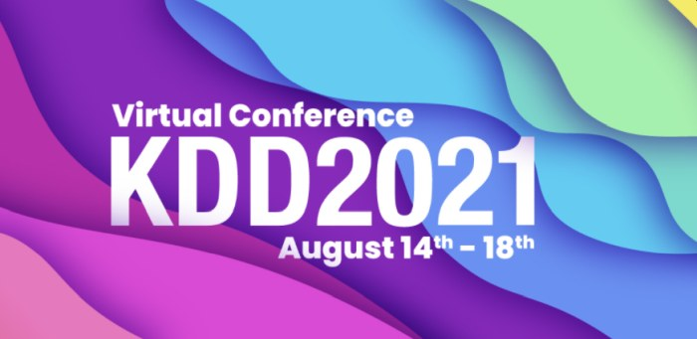
Software as a Medical Device: Regulating AI in Healthcare via Responsible AI
Muhammad Aurangzeb Ahmad ^{1,2}
Steve Overman¹
Christine Allen ¹
Vikas Kumar ¹
Ankur Teredesai ³
1. KenSci Inc. 2. Department of Computer Science, University of Washington Bothell 3. Department of Computer Science and Systems, University of Washington Tacoma
https://responsibleml.github.io/
August 14, 2021

Slide 2
Motivation and Foundations
Traditional Medical Device approval cycle and classes
Software as a Medical Device: Need and opportunities
Shortcomings of current regulations
Regulating Healthcare AI: Technical Challenges
Global and Interdisciplinary efforts
Demo and artifacts
Conclusion
Notes:
This tutorial is like a social gather place: Think of a coffee shop, a restaurant, a bar where a data scientist and a regulator or medical expert working on medical device technology have both walked in and are now sitting across having a conversation.

Slide 3
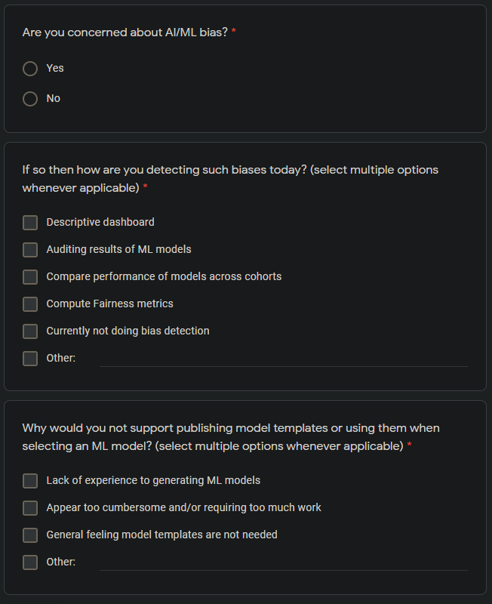
Survey on Responsible AI in Healthcare
bit.ly/2U3XDCm

Slide 4
[Hidden Slide: Internal Only]
(20 mins) Motivation: Cross Pollination so we speak the same language [Muhammad/Dr. Steve]
What can ML experts gain if they understand the SAMD landscape?
What can Regulators gain if they understand the ML advances and challenges?
(10 mins) Traditional Medical Device approval cycle and classes [Dr. Steve]
(20 mins) Software as a Medical Device: Need and opportunities [Muhammad/Dr. Steve]
Break (15 mins)
(10 mins) Shortcomings of current regulations and advances in AI [Muhammad/Dr. Steve]
What is a product
What is software
Packaging AI is like trying to shut a pandora’s box..
Key issues of fairness, concept drift, explanations, trust
(40 mins) Regulating AI: opportunities for the AI expert [Muhammad]
Break (15 mins)
(20 mins) Global efforts from Law, social science of other Responsible AI Landscape of frameworks [Muhammad]
(20 mins) Demo and artifacts [Vikas & Christine]
(10 mins) Conclusion [Muhammad]
Notes:
This tutorial is like a social gather place: Think of a coffee shop, a restaurant, a bar where a data scientist and a regulator or medical expert working on medical device technology have both walked in and are now sitting across having a conversation.

Slide 5
Motivation: Why is this conversation needed?
In mid 2010s FDA released a set of guidelines for Software as a Medical Device (SaMD) which proposed that AI algorithm of any clinical decision support to must have fixed set of parameters
A better model, with different parameters, with better performance could not be swapped and would have to be reapproved
Clinical validation of AI/ML models is mostly defined in terms of performance (Specificity, Sensitivity) or errors (Type I, Type II)
This model of ML assessment is detrimental to assessing long impacts of such models

Slide 6
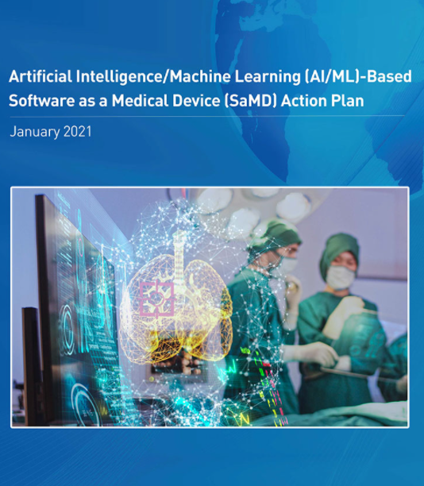
Motivation: SaMD Regulations for AI/ML Community
Regulations and guidelines for medical devices, real world usage of medical software are often opaque to machine learning and AI experts
Many researches are unaware of even how to start navigating the regulatory space
The parameters defined by regulatory bodies can be a great starting point for creating ethical, accountable and responsible AI systems in healthcare

Slide 7
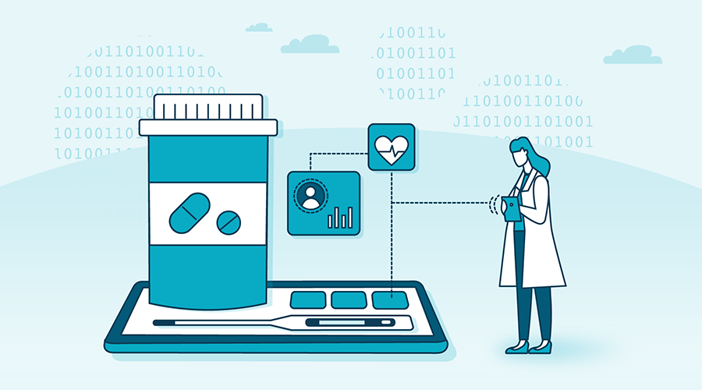
AI in Healthcare
AI in healthcare goes back the 1960s
Proliferation of massive healthcare datasets has expanded the application of AI/ML
In domains like Radiology and Diabetic Retinopathy, ML models have shown super-human performance
Total global healthcare spending in 2017 was $7.8 trillion or 10% of global GDP [Xu et al 2021]
Tremendous potential via AI/ML to the quadruple aim (i) Improve healthcare outcomes (ii) Reduce Costs (iii) Improve patient experience (iv) Improve clinician experience
Notes:
https://www.globenewswire.com/news-release/2021/01/19/2160281/0/en/Artificial-Intelligence-AI-in-Healthcare-Market-Size-Worth-61-59-Billion-By-2027-CAGR-of-43-6-By-Reports-and-Data.html

Slide 8
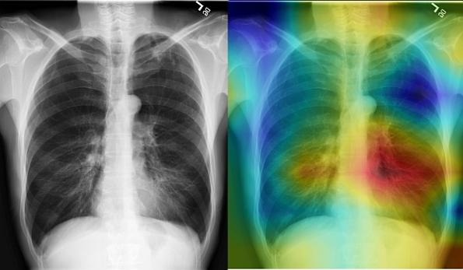
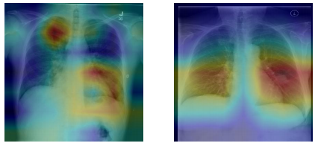
Why do we need ethical and responsible AI in Healthcare?
Consequences of decision making can be far-reaching e.g., recommend an operation, recommend sending a patient to hospice etc.
ML models can be opaque which may lead to distrust, bias and unfair outcomes [Doshi-Velez et al 2014; Ahmad et al 2018]
Cost of a mistake can be high e.g., misclassification of a malignant tumor can be costly and dangerous [Nature Editorial 2008]
[Rajpurkar 2017]

Slide 9
Failures of AI in Healthcare
One of the earliest examples (1970s) of algorithmic discrimination comes an algorithm used by St. George’s Hospital Medical School in the UK. It was discriminating admittance decisions based on race and gender
Idahoans with cognitive or learning disabilities had their healthcare benefits reduced by $20,000—30,000 based on an AI algorithm without any explanation. This led to a lawsuit by ACLU that revealed the underlying algorithm (Stanley 2017)
IBM’s Watson was “was offering erroneous, sometimes dangerous cancer treatment advice”
According to an IDC survey a quarter of commercial organizations in Healthcare AI have 50% failure rate of their AI initiatives (IDC 2019)
Notes:
Stanley, Jay. "Pitfalls of artificial intelligence decision making highlighted in Idaho ACLU case." Privacy & Technology (2017).
Artificial Intelligence Global Adoption Trends & Strategies, IDC, July 2019

Slide 10
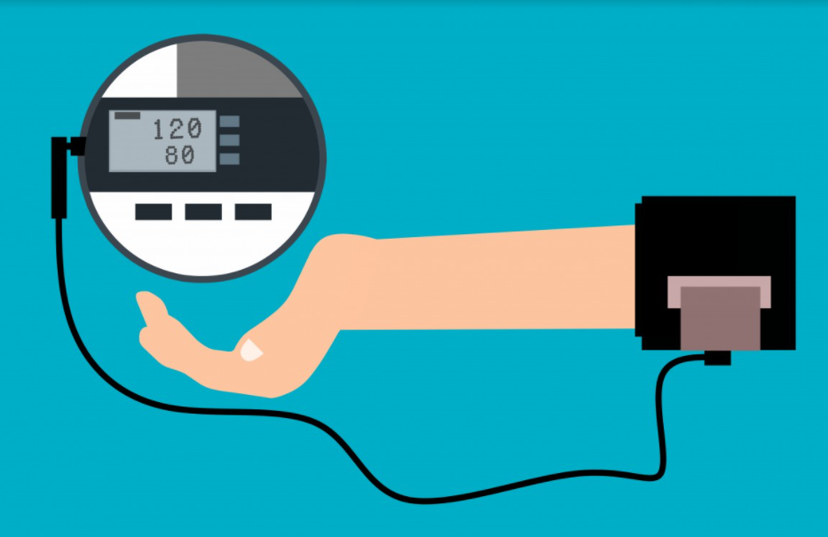
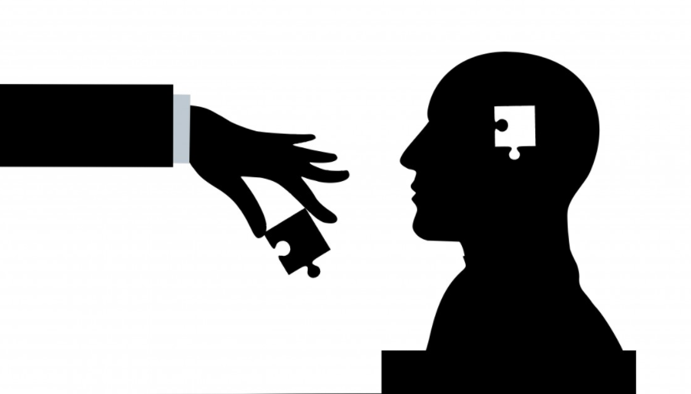
Unique challenges of AI in Healthcare
Most algorithms that feature prominently in research literature are in fact not, for the most part, executable at the frontlines of clinical practice (Panch et al 2019)
The last mile problem in AI is often overlooked because of the disconnect with domain experts and technical experts
Lack of access to datasets for understandable privacy reasons retards testing, growth and adoption of new technologies
Dynamic nature of ML models require retraining and recalibration of models
Notes:
While it’s unlikely that technology with “zero risk” can be developed, reducing the impacts of harmful biases in AI is possible and necessary

Slide 11

Optimizing for outcomes is (mostly) not optimizing objective functions
Trivializing healthcare problems by (partially) mapping them to a predictive problem and declaring victory
“People should stop training radiologists now. It is just completely obvious that within 5 years deep learning will do better than radiologists” - Geoffrey Hinton in 2016
“The role of the radiologist will be obsolete in five years” - Vinod Khosla in 2017
Notes:
While it’s unlikely that technology with “zero risk” can be developed, reducing the impacts of harmful biases in AI is possible and necessary
https://www.youtube.com/watch?v=2HMPRXstSvQ

Slide 12
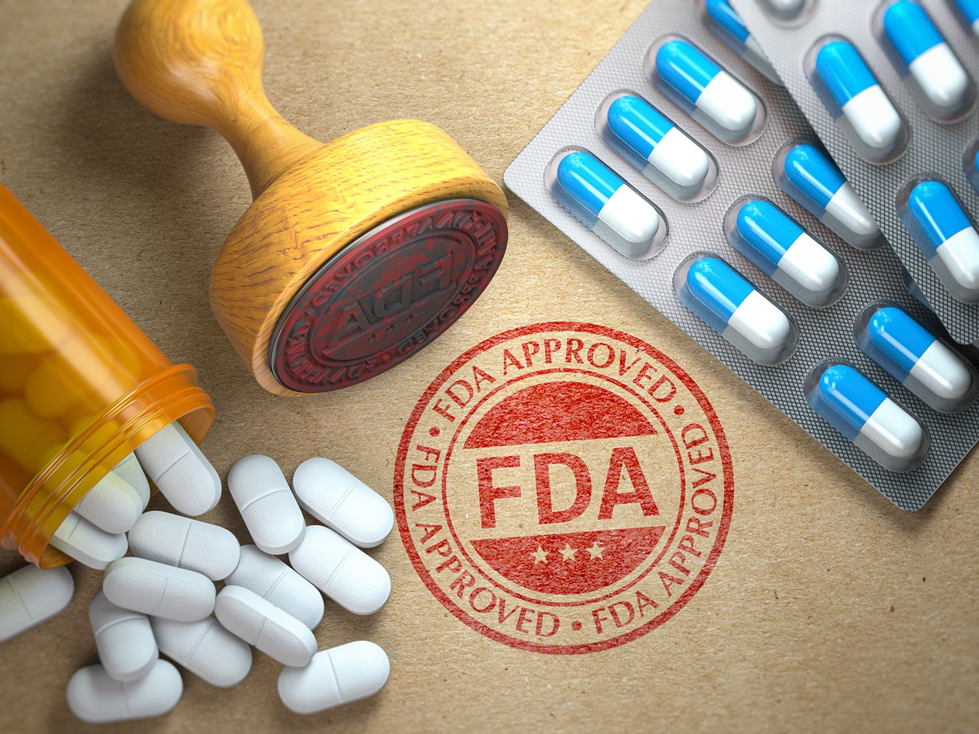
Regulating Medicine and Healthcare: Why Does FDA Exist?
“The Food and Drug Administration is responsible for protecting the public health by ensuring the safety, efficacy, and security of human and veterinary drugs, biological products, and medical devices; and by ensuring the safety of our nation's food supply, cosmetics, and products that emit radiation.”
What (medical devices) does FDA regulate?
simple items like tongue depressors and bedpans
complex technologies such as heart pacemakers
dental devices
surgical implants and prosthetics
Notes:
https://www.fda.gov/about-fda/what-we-do
https://www.fda.gov/about-fda/fda-basics/what-does-fda-regulate
The FDA has maintained its watch over the American consumer for a century. One of its most famous accomplishments was its rejection of thalidomide, a widely used drug that was later revealed to cause significant birth defects. The drug was marketed extensively in Europe in the late 1950s as a way to suppress morning sickness in pregnant women. At the time, doctors thought that drugs given to a mother couldn’t affect fetuses. Thus, they didn’t even bother to test its safety for developing babies.
When thalidomide’s manufacturers sought approval from the FDA to sell the drug in the U.S. in 1960, FDA inspector Frances Kelsey put the brakes on the process by requesting the company conduct more safety studies. The following year, reports of thousands of babies being born with severe birth defects started coming out. The FDA’s work on thalidomide earned Kelsey praise from President John Kennedy and helped spur the passage of amendments strengthening the FDA’s drug review process.
https://www.smithsonianmag.com/science-nature/origins-FDA-what-does-it-do-180962054/

Slide 13
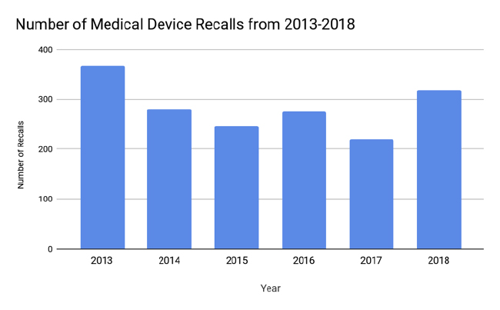
FDA’s Approvals at a glance
USA has the strictest regulatory regime for the approval of medical devices globally
In 2017 manufacturers recalled 4,402 drug and device products, according to the Center for Devices and Radiological Health and the Center for Drug Evaluation and Research
Of those recalls, 139 were as Class III (potential to cause serious harm or death)
[Source: Med Tech Intelligence]
Notes:
https://www.drugwatch.com/fda/recalls/

Slide 14
What is a Device?
An instrument, apparatus, implement, machine, contrivance, implant, in vitro reagent, or other similar or related article, including a component part, or accessory which is:
recognized in the official National Formulary, or the United States Pharmacopoeia, or any supplement to them,
intended for use in the diagnosis of disease or other conditions, or in the cure, mitigation, treatment, or prevention of disease, in man or other animals, or
intended to affect the structure or any function of the body of man or other animals, and which does not achieve its primary intended purposes through chemical action within or on the body of man or other animals and
which does not achieve its primary intended purposes through chemical action within or on the body of man or other animals and which is not dependent upon being metabolized for the achievement of its primary intended purposes. The term "device" does not include software functions excluded pursuant to section 520(o).
[Source: Section 201(h) of the Food, Drug, and Cosmetic Act]
Notes:
https://www.fda.gov/medical-devices/classify-your-medical-device/how-determine-if-your-product-medical-device

Slide 15
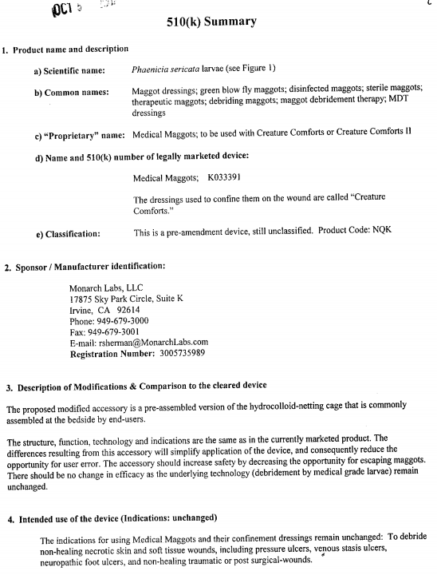
The definition of a Medical Device is very broad!
Maggots, leeches and worms are an FDA approved medical devices!
Maggot therapy involves a controlled maggot infestation on a wound for the medical removal of dead, damaged, or infected tissue
“The maggots macerate their food with their mouth hooks, release their digestive enzymes into the local environment, and ingest the liquefying and semi-solid tissue”
Source: FDA: Medical Maggots Product 510(k) Summary
Notes:
https://www.pharmacytimes.com/view/3-weird-things-the-fda-regulates-or-recognizes

Slide 16

Software in the Medical Device Regulatory World
There are three types of software related to medical devices
Software, which on its own is a medical device
Software in a medical device (Software that is integral to a medical device)
Software used in the manufacture or maintenance of a medical device.

Slide 17
What is Software as a Medical Device?
Software that is on its own a medical device, “without being part of a hardware medical device
“an instrument, apparatus, implement, machine, contrivance, implant, in vitro reagent, or other similar or related article, including any component, part, or accessory, which is (…) intended for use in the diagnosis of disease or other conditions, or in the cure, mitigation, treatment, or prevention of disease (…), which does not achieve its primary intended purposes through chemical action within or on the body of man (…), and which is not dependent upon being metabolized for the achievement of its primary intended purposes”.
[Section 201(h) of the Federal Food, Drug, and Cosmetic Act]
Notes:
FDA. Software as a medical device (SaMD). https://www.fda.gov/medical-devices/digital-health/software-medical-device-samd (2018). IMDRF. Software as a medical device (SaMD): key definitions. http://www.imdrf.org/docs/imdrf/final/technical/imdrf-tech-131209-samd-key-definitions-140901.pdf (2013).

Slide 18
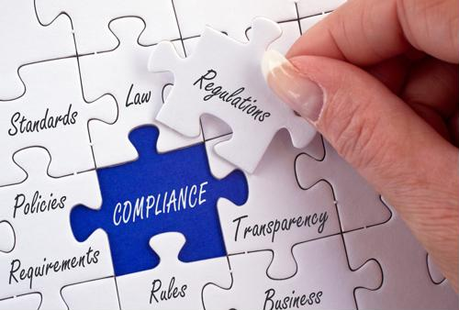
Regulations vs. Standards
Standards: Provide specifications (guidelines or requirements) for products, services and systems. Ensure quality, safety and efficiency. May provides details about acceptance criteria
Regulations: Detailed instructions on how laws are to be enforced. Regulations carry the force of law and thus their application is mandatory

Slide 19
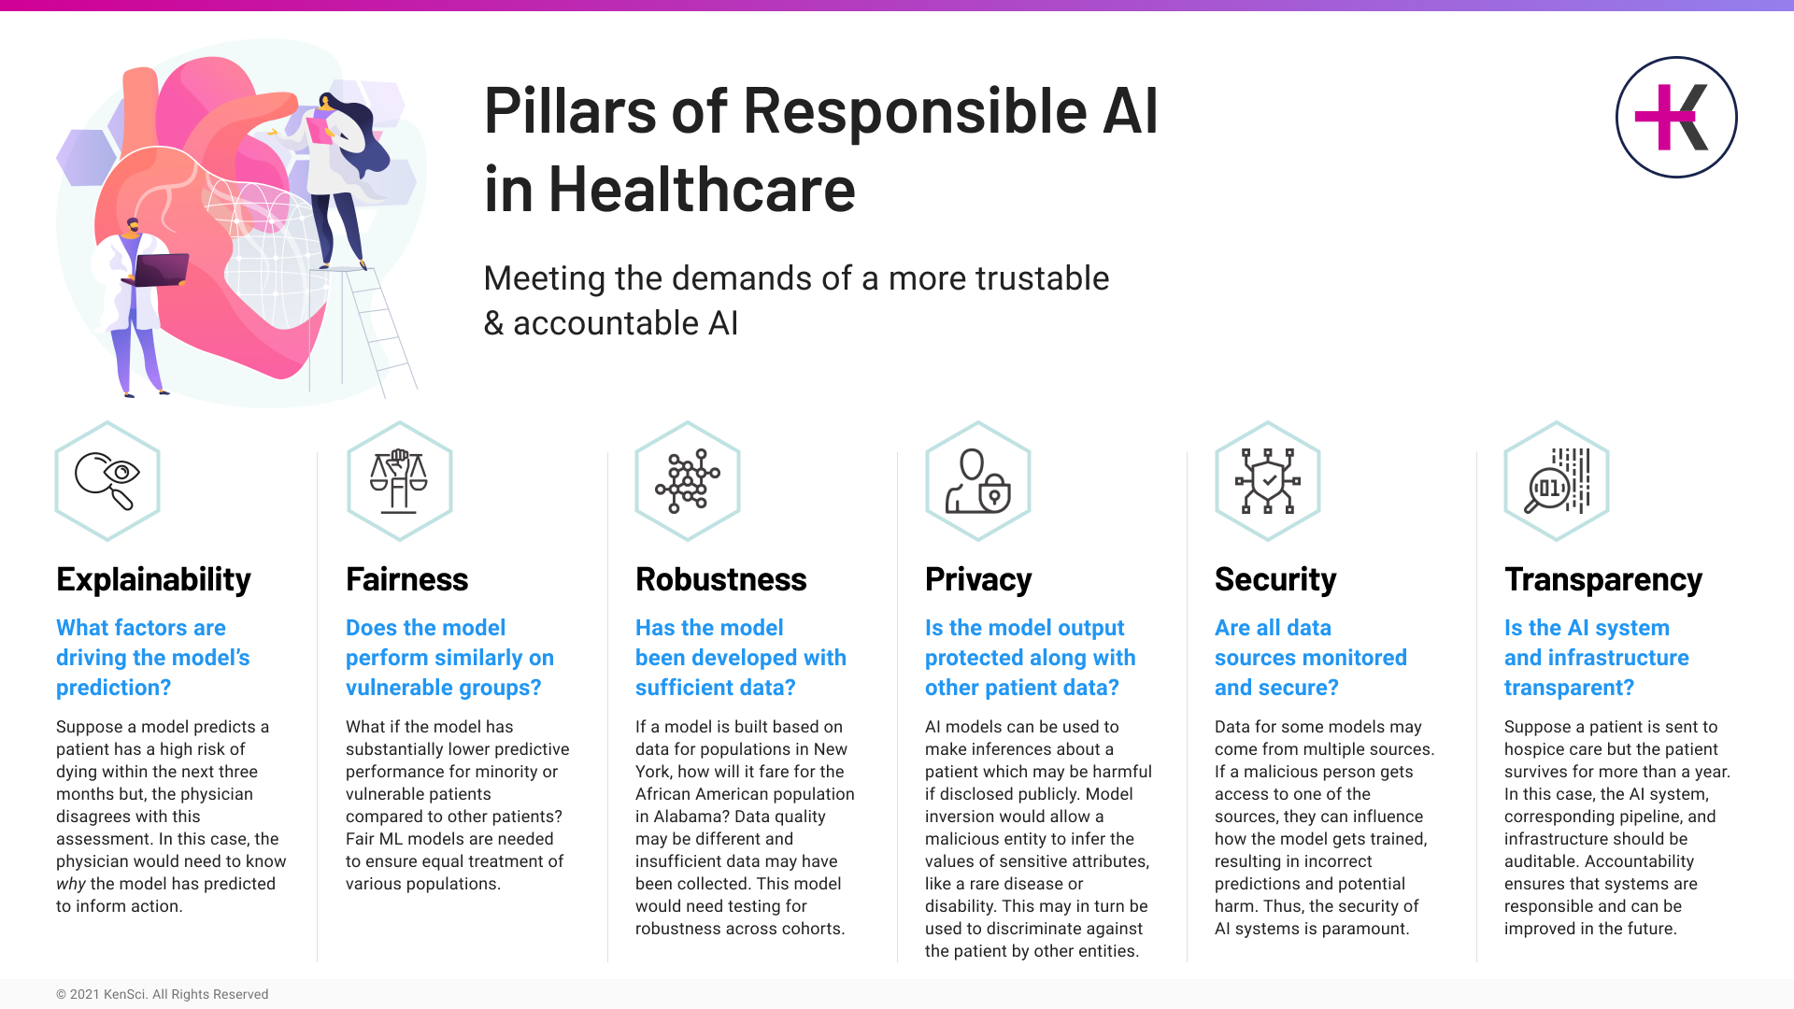
What is Responsible AI?

Slide 20
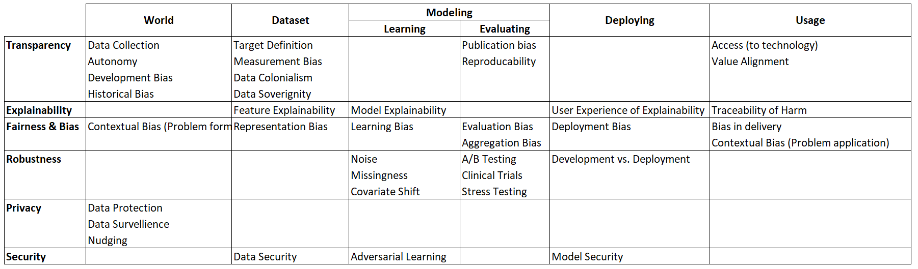
Responsible AI across the ML Cycle

Slide 21

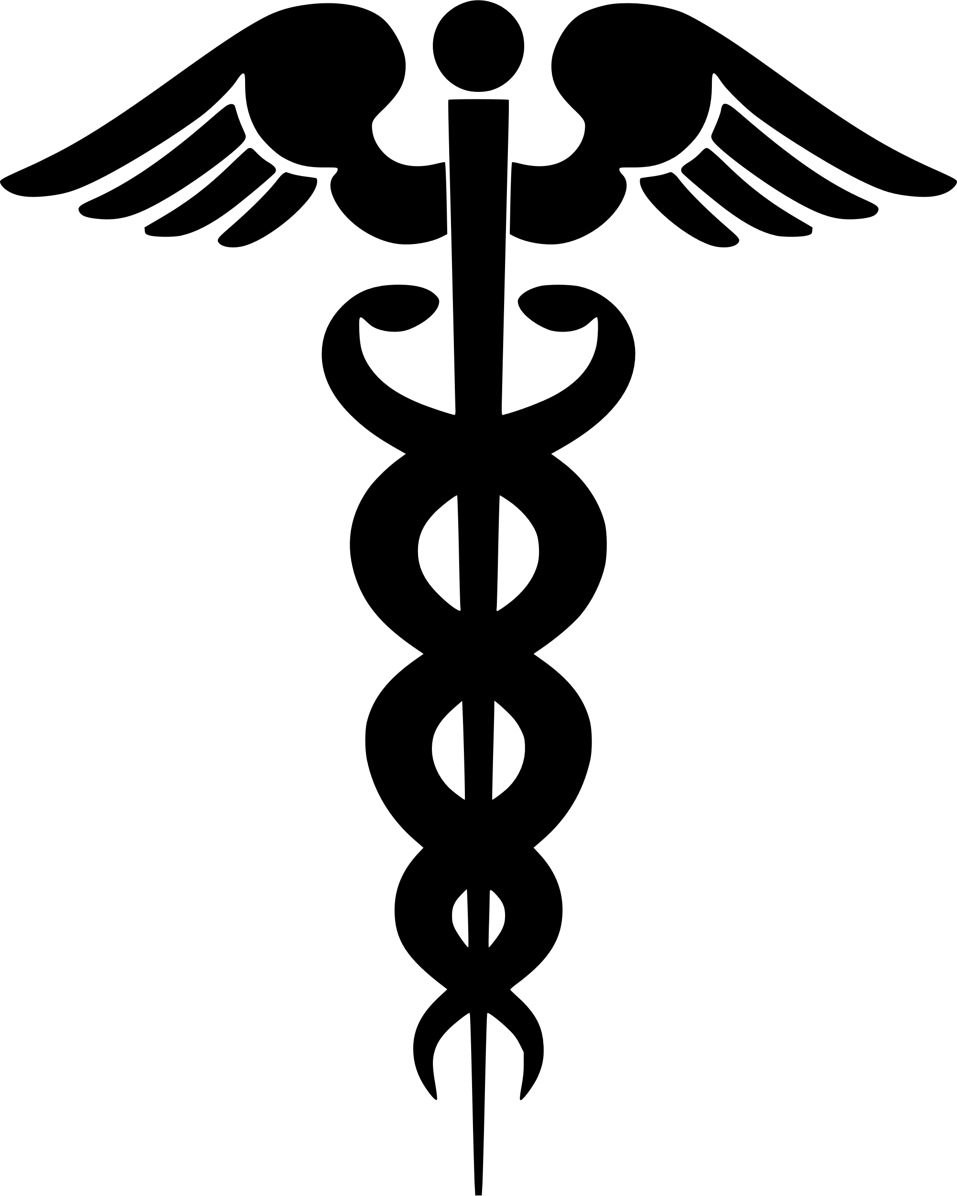

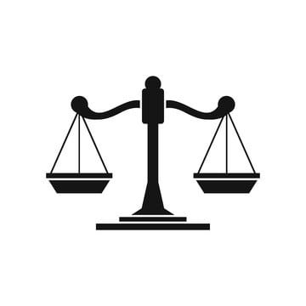

Ethical Principles in Healthcare
Nonmaleficence
Do no harm
Autonomy
Patient’s input should be respected
Justice or Fairness
Fair use of resources
Beneficence Promote Well Being
Dignity Patients have the right to dignity
[Beauchamp et al 2001; Page 2012]
Notes:
Autonomy: Deal with persons in ways that respect their interests in making decisions about their lives and their person, including health-care decisions, according to informed understanding of the nature of the choice to be made, its significance, the person’s interests and the likely consequences of the alternatives

Slide 22
Traditional Medical Device approval cycle and classes

Slide 23
Problems with Drug & Device Approval
“lots of carelessness is involved during the drug development and manufacturing period. The long list of drug recall on FDA website is evidence that still industries are not following the standard guidelines.”
- Nagaich & Sadhna, Int J Pharm Investig 2015
“Many high-risk medical devices today are approved on the basis of just one clinical trial (as opposed to new medications, which usually require two trials). And only a small minority of clinical studies of medical devices are randomized, controlled and blinded — the gold standard for reliable evidence (and the benchmark to which studies of drugs are held).”
- Redberg & Dhruva, NYT 2015

Slide 24
Regulating Medical Products
Medical products are different from other consumer goods or products
The principal purpose regulatory systems for medical devices is to ensure well-being, safety and performance
Software that is incorporated into a medical device may be subject to regulation from multiple jurisdictions e.g., US, China, EU etc.
Risks differ by device type
What regulations may apply for what type of devices?

Slide 25
History of FDA Regulation
Federal Food, Drug, and Cosmetic Act of 1938: Prohibited the marketing of medical devices with false or misleading labeling
Radiation Control for Health and Safety Act of 1968 Established performance standards to control radiation from various products
Medical Device Amendments of 1976 Established the premarket approval and 510(k) pathways and the risk-based classification of medical devices into classes I, II, and III.
Safe Medical Devices Act of 1990 Added Section 522 studies, created Humanitarian Device Exemption for devices for rare diseases or conditions
FDA Modernization Act of 1997 Exempted most class I devices from premarket notification, created the Third-Party Review Program for 510(k) submissions
[Darrow et al 2021]
Notes:
Federal Food, Drug, and Cosmetic Act of 1938
Prohibited the marketing of medical devices prepared in unsanitary conditions or bearing false or misleading labeling.
Radiation Control for Health and Safety Act of 1968
Authorized the Secretary of Health, Education, and Welfare (the predecessor to the Department of Health and Human Services, within which the FDA is situated) to establish performance standards to control the emission of radiation from a broad range of products, including medical devices such as diagnostic X-ray equipment.
Medical Device Amendments of 1976
Provided the FDA with comprehensive authority to regulate medical devices, including the establishment of the premarket approval and 510(k) pathways and the risk-based classification of medical devices into classes I, II, and III.
Safe Medical Devices Act of 1990
Increased postmarket reporting and surveillance requirements, including Section 522 studies, and created the Humanitarian Device Exemption for devices addressing a disease or condition affecting fewer than 4000 (now 8000) people in the US per year.
FDA Modernization Act of 1997
Exempted most class I devices from premarket notification, created the Third-Party Review Program for 510(k) submissions, authorized expanded access to investigational devices, and required the FDA to inform applicants of the “least burdensome” means of establishing effectiveness for premarket approvals or substantial equivalence for 510(k) submissions.

Slide 26
History of FDA Regulation
Medical Device User Fee and Modernization Act of 2002 Established a user fee program by which medical device manufacturers pay fees that help fund FDA review activities
FDA Safety and Innovation Act of 2012 Eliminated the requirement to first submit a 510(k) prior to eligibility for de novo review, and directed the FDA to include devices in its postmarket risk identification
21st Century Cures Act of 2016 Established the Breakthrough Devices Program, excluded most clinical decision support software from the definition of medical device
FDA Reauthorization Act of 2017 Authorized risk-based inspection scheduling for device manufacturers
[Darrow et al 2021]
Notes:
Medical Device User Fee and Modernization Act of 2002
Established a user fee program by which medical device manufacturers pay fees that help fund FDA review activities and provided definitions of panel-track supplements, 180-day supplements, real-time supplements, and efficacy supplements.
FDA Amendments Act of 2007
Reauthorized device user fees and directed the FDA to require unique device identifiers.
FDA Safety and Innovation Act of 2012
Reauthorized device user fees, eliminated the requirement to first submit a 510(k) prior to eligibility for de novo review, and directed the FDA to include devices in its postmarket risk identification system (Sentinel).
21st Century Cures Act of 2016
Established the Breakthrough Devices Program, excluded most clinical decision support software from the definition of medical device, and raised the Humanitarian Device Exemption limit from 4000 to 8000.
FDA Reauthorization Act of 2017
Reauthorized device user fees and authorized risk-based inspection scheduling for device manufacturers.

Slide 27
FDA Device Classification
Class I | Class II | Class III
Low | Medium | High
Electric Toothbrush Tongue Depressor Oxygen Mask Reusable Surgical Scalpel Bandages Hospital Beds | Blood Pressure Cuffs Pregnancy Test Kits Syringes Blood Transfusion Kits Contact Lenses Surgical Gloves | Breast implants Pacemakers Defibrillators Cochlear implants Fetal blood sampling monitors Implanted prosthetics
47% of medical devices fall under this category and 95% of these are exempt from the regulatory process | 43% of medical devices fall under this category | 10% of medical devices fall under this category
Notes:
https://www.fda.gov/about-fda/cdrh-transparency/overview-medical-device-classification-and-reclassification
https://www.bmpmedical.com/blog/whats-difference-fda-medical-device-classes-2/

Slide 28
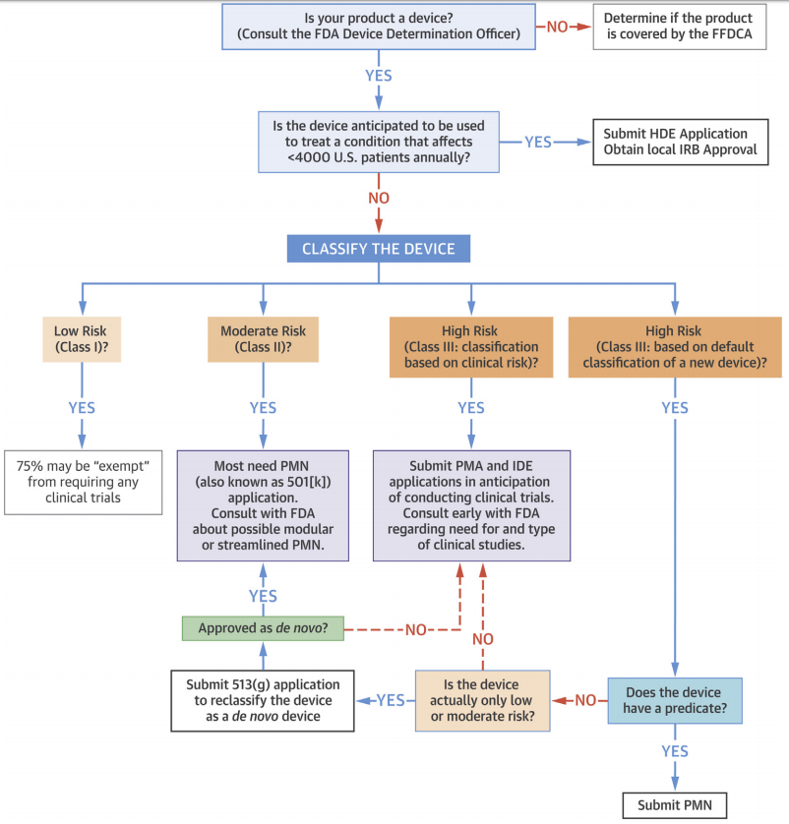
Product to Market Cycle I: Establish the Product
What kind of product is this? e.g., instrument, apparatus, machine, implant, component, part, accessory
What is the focus e.g., diagnoses, cures, mitigates, treats, or prevents disease or condition
Affects structure or function of body
Excludes certain software functions e.g., data storage

Slide 29
Product to Market Cycle II: Identify Purpose
What is the general intended use of the product?
What are the specific indications for use
For how long is the product likely to be used?
Describe target patient population e.g., age, disease etc.

Slide 30
Product to Market Cycle: Verification & Identification
Verify that Product is Medical Device
Identify Device Classification
Identify Regulatory Pathway
Classification usually indicates the regulatory pathway (premarket submission type) required for device

Slide 31
Product to Market Cycle: Evidence & Submission
Develop Valid Scientific Evidence
CFR 860.7(c)(1) – requires valid scientific evidence for safety and effectiveness
CFR 860.7(c)(2) – provides definition of valid scientific evidence
Prepare Premarket Submission
Notes:
Processes
Applicable Laws and Regulations
Review Times
Evidence Burden

Slide 32
FDA Medical Device Approval Pathway
“A 510(k) is a premarket submission made to FDA to demonstrate that the device to be marketed is as safe and effective, that is, substantially equivalent, to a legally marketed device (section 513(i)(1)(A) FD&C Act). The submitter may market the device immediately after 510(k) clearance is granted.” [FDA]
[Van Norman 2016]
Notes:
PMN = Premarket notification 510k
Van Norman, G.A. J Am Coll Cardiol Basic Trans Science. 2016;1(4):277–87

Slide 33
Premarket Submission Types
Submission Type | Explanation
Investigational Device Exemption (IDE) | Investigational device to be used in order to collect safety and effectiveness data
Premarket Notification (510(k)) | Device to be marketed is as safe and effective, that is, substantially equivalent, to a legally marketed device
Premarket Approval Application (PMA) | Demonstrate the safety and effectiveness of the Class III device
De Novo | Device has no existing classification regulation
Humanitarian Device Exemption (HDE) | Reasonable assurance of safety and probable benefit
Notes:
De Novo is default Class 3 until further investigation

Slide 34
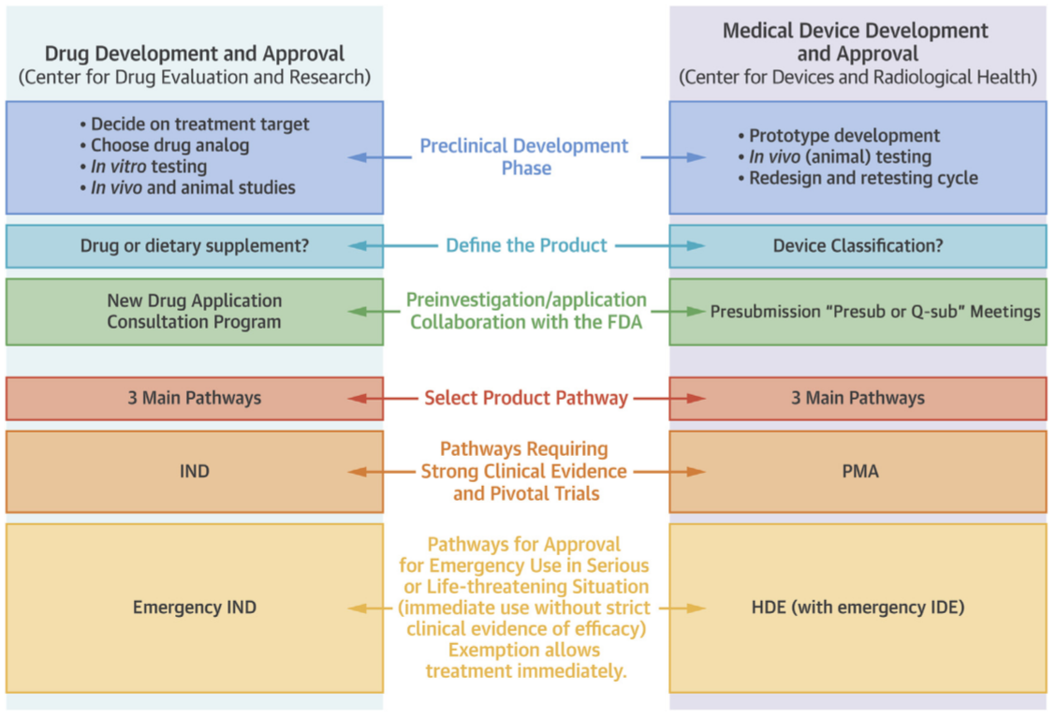
FDA Approval for Drugs and Devices
Notes:
Van Norman, G.A. J Am Coll Cardiol Basic Trans Science. 2016;1(4):277–87

Slide 35
“…members of the public do not need to trust individual AIs at all; what they need instead is the sanction of authority provided by suitably expert auditors that AI can be trusted”
- Knowles and Richards 2021
Notes:
It is then problematic that members of the public are severely limited in their ability to process trust at multiple points along this path: [Knowles and Richards]

Slide 36
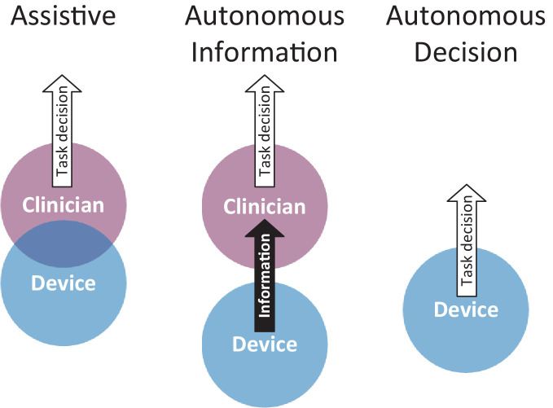
Software as a Medical Device (SaMD) and ML
Assistive devices: Overlap in what clinician and device contribute to the task
Autonomous Information: Separation between what device and clinician contribute to the task
Autonomous decision: Device provides the decision for the clinical task which can then be enacted by clinicians or the device itself
Zero Level: Absence of automation
[Lyell et all 2021]
Notes:
Assistive: but where clinicians provide the decision on the task. Such overlap or duplication occurs when clinicians need to confirm or approve device provided information or decisions.
Autonomous: where devices contribute information that clinicians can use to make decisions.
Zero: , representing the complete absence of automation where clinicians perform tasks manually without any device assistance.

Slide 37
Types of Regulated Software
Medical Device Software
Software that is part of the medical device itself
Software that is an accessory to a medical device
Software that itself is a medical device (SaMD)
Non-Device Software that is part of
The quality system software
Software used to create and maintain records required by the FDA

Slide 38
IEC 62304 – Medical device software Life Cycle
IEC 62304 is a standard which specifies life cycle requirements for the development of medical software and software within medical devices
First recognized as a benchmark to comply with regulatory requirements from USA and the EU
IEC 62304 defines the software development and verification activities which Medical Device manufacturers must comply with
Includes risk management, configuration management and problem resolution processes at each phase of software development)
Notes:
Standard in the European Union and USA
China – CFDA adopted 62304
Translations exist in French, German, Spanish, Chinese and Japanese
Adopted as a Japan Industry Standard

Slide 39
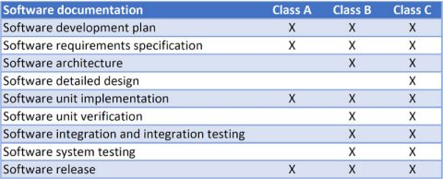
IECE 62304 Safety Classes
Responsibility of the manufacturer includes produce maintenance
The manufacturer is required to monitor and document feedbacks
62304 identifies three safety classes for medical device software:
Class A: No injury or damage to health is possible.
Class B: Injury is possible, but not serious.
Class C: Death or serious injury is possible
[Source: Mathworks]
Notes:
The manufacturer is required to monitor and document the feedbacks both within organizations and users
Under IEC 62304, responsibility of the manufacturer also goes beyond the release of the software product, with particular emphasis on product maintenance
This feedback must be analyzed to determine whether a problem exists
https://www.mathworks.com/discovery/iec-62304.html

Slide 40
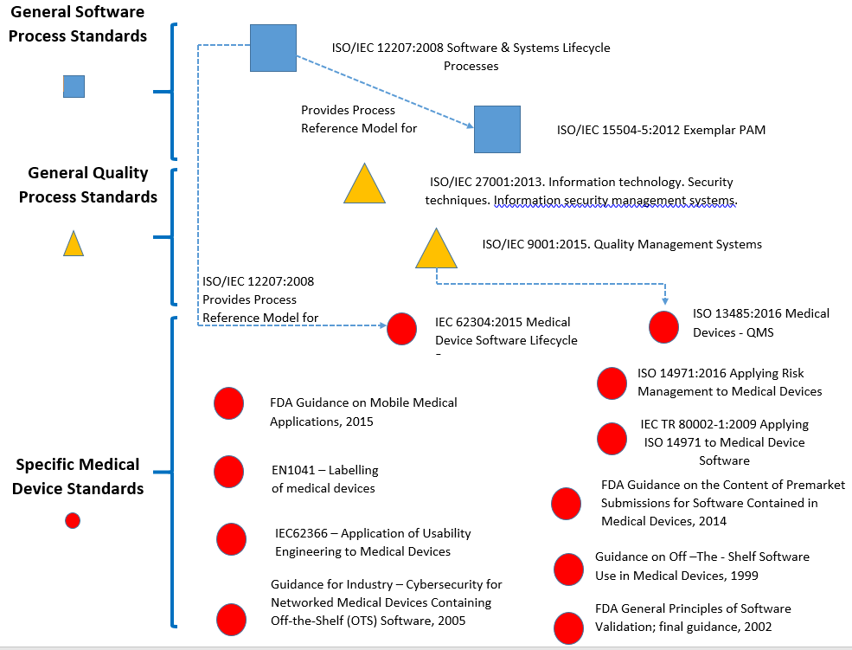
Regulatory Landscape for SaMD
[Source: DataArt]

Slide 41
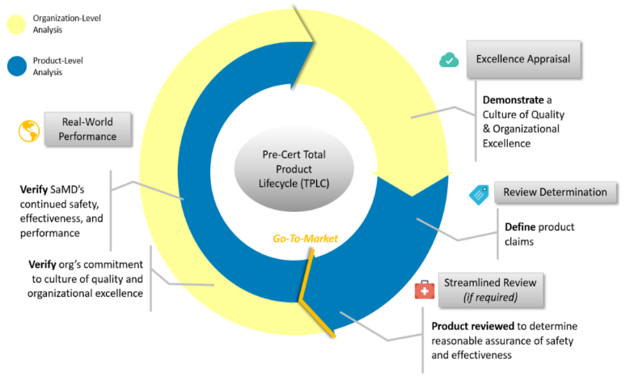
FDA’s Pre-Cert Program
FDA first examines the technology developer rather than the device
Companies that pass get Pre-Cert process which can a streamlined review of SaMD
A test plan in 2019 assessed the appraisal of SaMD firms and the accompanying streamlined review
Apple, Fitbit, Johnson & Johnson, Samsung, as well as several much smaller companies were included in the first review
[Oakes 2020; Kay 2017]
Notes:
Official public statements seem to imply that these pre-certified companies might one day be permitted to optimize their software products without seeking FDA approval upon every iteration—though Patel, who comes to his job with a strong background in business development and technology, is studiously noncommittal on this point.
A test plan in 2019 assessed the appraisal of SaMD firms and the accompanying streamlined review process are equivalent to the traditional medical device clearance pathway in terms of achieving “reasonable assurance of safety and effectiveness.”

Slide 42
SaMD vs. Variance in ML Systems
The behavior of traditional software is deterministic in contrast to probabilistic nature of machine learning
In general AI/ML-based SaMD have greater variance between performance in testing vs. development settings
From regulator’s perspective there is more risks and less certainty over their benefits
“Unlike drugs, the usage of software and generally Information Technologies (IT) is known to be highly affected by organizational factors such as resources, staffing, skills, training, culture, workflow, and processes”
[Gerke et al 2021]
Notes:
“Variance can increase due to human factors or the complexity of these systems and how they interact with their environment”

Slide 43
Survey on Responsible AI in Healthcare
bit.ly/2U3XDCm

Slide 44
Break 1 (15 minutes)

Slide 45
Shortcomings of current regulations and advances in AI

Slide 46
“There’s a reason that tech companies like Google haven’t been going the FDA route [of clinical trials aimed at diagnostic certification. It can be a bureaucratic nightmare, and they aren’t used to working at this level of scrutiny and slowness.” He notes that just getting a basic ISO 13485 certification, which acts as a baseline for the FDA’s device standards, can cost two years and seven figures. “How many investors are going to give you that amount of money just so you can get to the starting line?”
- Robert Kaul, the founder and CEO of Cloud DX
Notes:
https://www.fda.gov/media/75903/download
[Kay 2017]

Slide 47
Limits on FDA’s Regulatory Scope
The 21st Century Cures Act excludes from FDA’s regulatory regime: “devices that support or provide recommendations to a healthcare professional, and the healthcare professional has the opportunity to “independently review the basis for such recommendation” are excluded from the definition of device
Section 1557 (Civil Rights of 1964) “prohibit health entities from discriminating against patients on the basis of race, ethnicity, national origin, sex, age, or disability.” Some courts have permitted disparate-impact liability for all grounds prohibited under Section 1557; Other courts, however, have held that Section 1557 allows for disparate impact liability only where the originating statutory basis provided for it
Notes:
21st Century Cures Act, Pub. L. No. 114-225, § 3060(a), 130 Stat. 1033 (codified as amended at 21 U.S.C. § 520(o)(E)(ii)–(iii)).
Specifically, the Act excludes devices that meet these criteria from the definition of medical device: (1) not intended to analyze medical images or signals from in vitro diagnostic devices or analyze a pattern from signal acquisition systems; (2) intended to be used to display, analyze or print patient medical information (or information from clinical studies); (3) intended to support or give recommendations to healthcare professionals about preventing, diagnosing, or treating diseases; and (4) intended to be independently reviewed by a healthcare professional (as opposed to professional primarily relying on the recommendations).
(1) Title VI of the Civil Rights of 1964, (2) Title IX of the Education Amendments of 1972, (3) the Age Discrimination Act of 1975, or (4) the Rehabilitation Act of 1973. Stated simply, the statute and regulations implementing Section 1557 prohibit health entities from discriminating against patients on the basis of race, ethnicity, national origin, sex, age, or disability
The Office of Civil Rights (OCR) within the U.S. Department of Health and Human Services is tasked with implementing and enforcing Section 1557
OCR does not have a policy regarding how to handle ML cases
Examples of cases handled: English language non-proficiency access issues, male domestic violence victims
What do the following mean in an AI/ML context?
Compliance
Grievance Procedures
Some courts have permitted disparate-impact liability for all grounds prohibited under Section 1557; they justify that it would lead to absurd and inconsistent results if only some plaintiffs could proceed without a showing of intentional discrimination
Other courts, however, have held that Section 1557 allows for disparate impact liability only where the originating statutory basis provided for it

Slide 48
Limitations of the (current) Regulatory Landscape
Lack of specifics e.g., prescribing fairness as a requirement without specifying what constitutes fairness
Traditional norms of ethical guidelines in healthcare do not carry over
Insufficient focus on the ML process/product life cycle i.e., ML in the real world
Lack of specifics also imply that reconciling ethical norms with Silicon Valley’s “fast growth, fast failures and getting first to the market” is not always straight forward
Lack of sanctions imply that there is minimal deterrent to poor practices

Slide 49
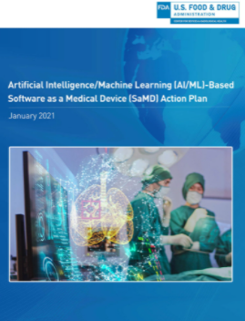
Shortcomings of FDA’s Guidelines
FDA’s recommendations are non-binding
FDA guidelines do not cover models for predictive modeling in administrative settings (which can have potential adverse on patients)
The added caveats introduced by the 21st Century Cures Act leave a large portion of healthcare AI technology unregulated
None of the FDA’s proposed frameworks adequately address the potential for disparate impacts
In the limited instances where the FDA does plan to regulate Device CDS, it is likely that its focus will be primarily on safety and effectiveness rather than AI bias

Slide 50
FDA’s Traditional model vs. AI
Traditional Model: Any product may be clinically tested, produced, marketed, and used in a defined, unchanging form
AI/ML systems are analogous to meta-algorithms that improve and change over time (addition of new data, new algorithms)
Expand Definition of Change: Limited change in model configuration or model parameters does not require recertification
Limits of Pre-Cert Program: Certifying organizations may not be sufficient since context change in AI/ML may not always carry over what constitutes due diligence for Responsible AI system
[Kay 2017]

Slide 51
Regulatory Limitations: Traceability of Harm
Problem: How does one attribute of responsibility within complex systems in which responsibility is distributed among multiple entities
“When medical decisions by AI technologies harm individuals, responsibility and accountability processes should clearly identify the relative roles of manufacturers and clinical users in the harm”
Diffusion of responsibility : “everybody’s problem becomes nobody’s responsibility”
Possible Solution: No fault compensation in New Zealand where patients seek compensation for medical injuries through a no-fault, no-liability scheme

Slide 52
Regulatory Limitations: Are ML models Products?
Product liability for most use cases of AI models is limited because most of these are considered as services and not as products
Concept different, context bias and black-box nature of ML limit the applicability of current regulatory regimes
Learned intermediary Doctrine limits liability for the developer e.g., “when a doctor prescribes drugs or devices for which the manufacturer has provided adequate information, such as warnings about risks … break the line of causation between a product developer and the patient who has suffered harm “

Slide 53
Regulatory Limitations: Technical Challenges
Large scale deployment of AL/ML systems is relatively new and fast evolving
Any proposed set of regulations should focus on process, outcomes and guarantees e.g., theoretical guarantees that come with certain algorithms
Justification for problem mapping e.g., thresholding for classification, conversion of regression problems to classification based on distributions
Notes:
The tech sector itself is trying to figure things out

Slide 54
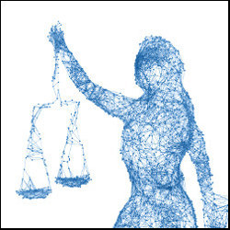
Regulatory Limitations: Defining Fairness & Measuring Bias
While the guidelines call for stakeholder centric approaches, defining what constitutes due diligence remains a challenge
Review of training data for bias
Guidelines do not include testing for disparate-impact
Model analysis for fairness and bias may not be sufficient if downstream long-term effects are not considered
[Source: Communication of the ACM]
Notes:
Lack of standards is thus understandable
Long term effects are difficult to define and measure

Slide 55
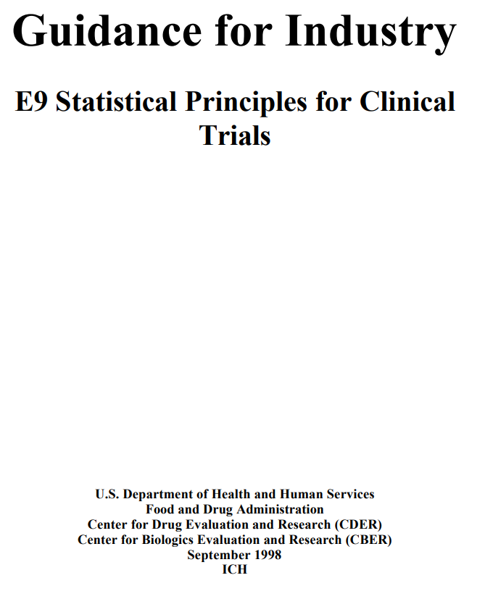
Principles for Responsible AI in Healthcare?
FDA’s Guidance for Industry E9 Statistical Principles for Clinical Trials provide broad guidelines for clinical trials
Delve deeper into recommended practices while leaving room for modification for specifics
Enunciation of a similar set of principles for FDAs regulations and goals via Responsible AI may needed

Slide 56
Responsible AI and Regulation in Healthcare
“No specific ethical principles for use of AI for health have yet been proposed for adoption worldwide” [WHO 2021]
AI in healthcare opens the issues of safety and responsibility at scale
Lack of regulation means that in case of misalignment of corporate incentives vs. public good, the former may dominate
Given the lack of complimentary expertise in both healthcare and machine learning it is often not clear what constitutes responsible AI in healthcare and what needs to be regulated
Notes:
Responsible AI has additional constraints in Healthcare
Decisions in Healthcare can have long term consequences
Long term health outcomes are of the result of hundreds of individual actions involving patient, clinicians and other healthcare personnel

Slide 57
Ethics Washing in Healthcare AI
“Ethics” in the tech industry is being used for calls for Self-Regulation
Ethics Washing: Use of “ethics” with shallow appearance of ethical behavior to ward-off regulation
Ethics Bashing: Ethics being trivialized as having an ethics board or a plan for self-governance rather than a mode of thinking, as a consequence of ethics washing
[Wagner 2018; Bietti2020]
Notes:
The misunderstandings underlying ethics bashing are at least three-fold: (a) philosophy and “ethics” are seen as a communications strategy and as a form of cover-up or façade for unethical behavior, (b) the role and importance of moral philosophy is downplayed and portrayed as mere “ivory tower” intellectualization of complex problems that need to be dealt with in practice; and (c) philosophy is understood in opposition and as alternative to political representation and social organizing.

Slide 58
Regulating AI: Opportunities for the AI expert

Slide 59
“We’re headed toward a zero-code world, where AI writes it for you or you just say what you want and natural language processing takes care of the rest. The pace will be tremendously faster than what we’re seeing today. The question is, how do we align our regulations to that radically different development timeline?”
- Bakul Patel, Digital Health Center of Excellence, FDA
[Molteni 2017]
Notes:
We will discuss two main types of challenges – Technical and cultural

Slide 60
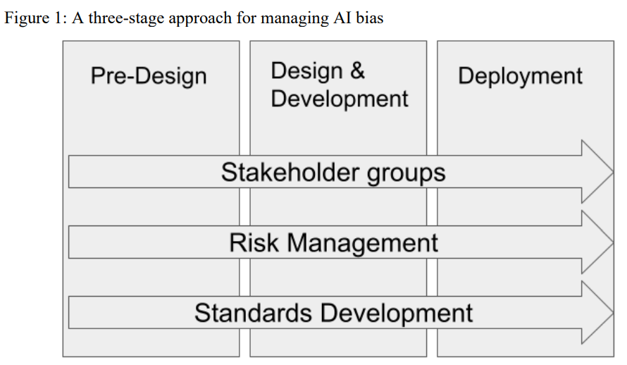
Responsible AI across the AI/ML Life Cycle
[IT Modernization CoE; OECD Legal Instruments]

Slide 61
Responsible AI across the ML Cycle Revisited

Slide 62
Stakeholders in the Machine Learning Cycle
Model Design | Review the goal of the ML model with diverse and representative stakeholders Evaluate current initiatives which may be interacting with proposed model / workflow and consider what downstream consequences may be Discuss ethical concerns about model use and / or misuse
Data Collection | Determine which features and which patient groups should be considered protected or surrogates of protected Evaluate relationship between surrogate and outcome Assess if the protected groups are adequately represented.
Training | Apply pre-processing, in-processing and post-processing techniques to make the model more fair
Evaluation | Engage with stakeholders, patient groups representatives, data scientists, machine learning experts to determine what are appropriate evaluation metrics given the use case Determine what processes will be affected by different model outputs (allocation)
Deployment and Review | Monitor the results and periodically check with the stakeholders regarding how the model is affecting them
Notes:
Yet, awareness of which conditions will lead to disparate impact or other negative outcomes is not always apparent in pre-design, and can be easily overlooked once in production
Lack of diverse stakeholders in planning
Insufficient data

Slide 63

Data: Trouble with Labels
Data: Trouble with Labels
Data labels are generally derived from the Electronic Health Records (EHRs)
Labeling incentives may change as healthcare processes change (e.g., Meaningful Use criteria, HEDIS measures)
Definitions of an outcome may change over time e.g., thresholds that define a disease
Mental health evaluations, psychological assessments, pain assessment by clinicians vs. patients, patient reported outcomes may vary
Racial and sex/gender biased disparities have been observed for pain assessment across multiple studies
Optimizing for the wrong label can lead to biased outcomes
Notes:
Cholesterol, Vitamin D
ICD codes

Slide 64
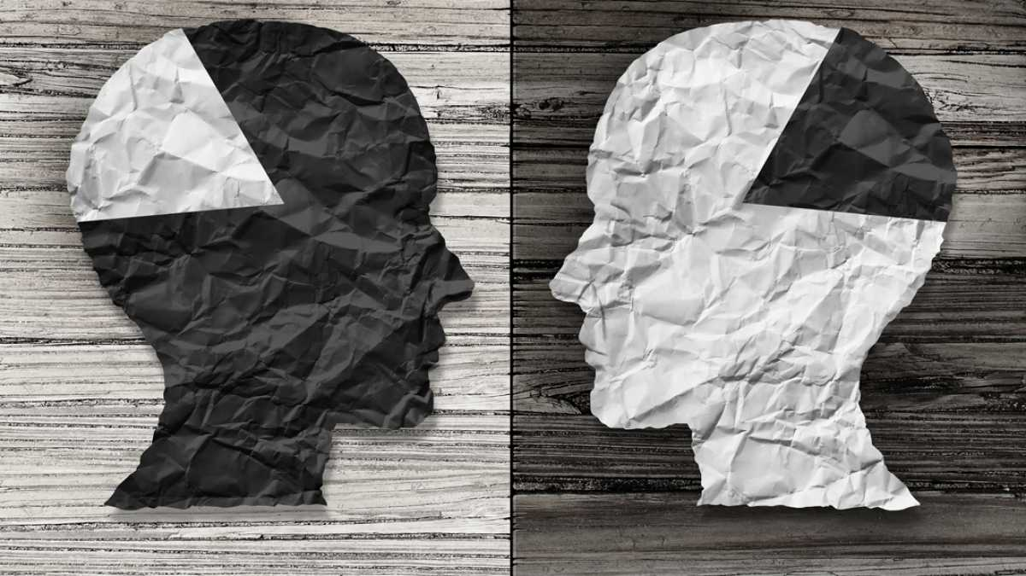
Data: Trouble with Labels
Data: Minority Classes & Generalization
In sub-Saharan Africa, women are diagnosed with breast cancer younger, on average, than are their peers in developed countries, and their disease is more advanced at diagnosis. Diagnostic AI tools trained on mammograms from European women are primed to identify disease in its early stages in older women [Nordling 2019]
Data security and access concerns have been raised about allowing developers to access such data from low-income countries
Notes:
Companies offer to pay for such data, he says, which might tempt cash-strapped national health systems or individual researchers to part with patient data, perhaps without thinking hard about the rights of the those whose data they are sharing. A number of developing countries are introducing data-protection laws, but in those countries where law enforcement is lax, such regulations could be circumvented.

Slide 65
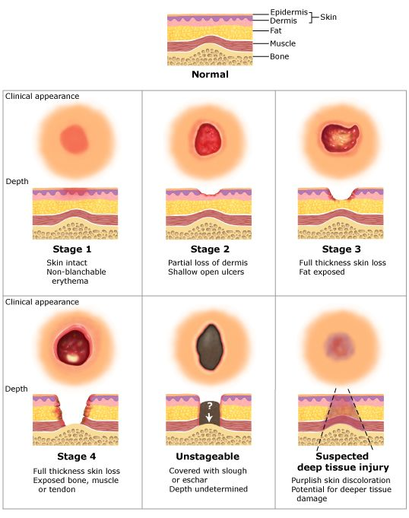
Data: Trouble with Labels: Pressure Injury
“Localized damage to the skin and underlying soft tissue, usually over a bony prominence or related to a medical or other device.” NPUAP
Multiple risk assessment exist for pressure injury (PI). The Braden Scale is the most widely used scale
All measurement scales for PI are highly subjective in nature
Notes:
The injury occurs as a result of intense and/or prolonged pressure, or pressure in combination with shear
Marker of poor overall prognosis
May contribute to premature mortality in some patients
Commonly seen in high-risk populations (elderly and very ill)
Vary by clinical setting, and is a potentially preventable condition

Slide 66
Data, Practice of Medicine and AI
Decisions regarding what data to use in a model is often dependent upon what is available accessible instead of what is most suitable [Fish et al 2020]
Researchers often start with the data instead of hypothesis [Tromble 2021] inverting how medicine and science is traditionally practiced
Data can also differ significantly between development and (real world) deployment [Jacobs et al 2020; Jacobs et al 2021; Passi et al 2019]
There may not be enough data for certain people because they lack [C. D’Ignazio and L. Klein 2020]
Notes:
https://nvlpubs.nist.gov/nistpubs/SpecialPublications/NIST.SP.1270-draft.pdf

Slide 67
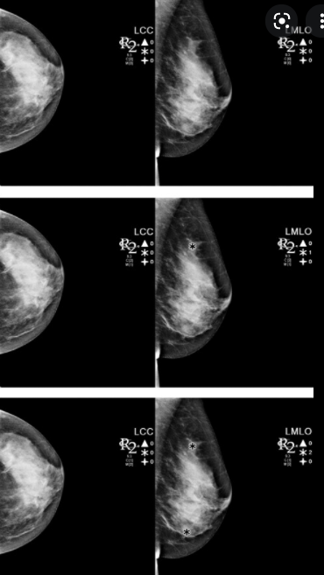
Unintended Consequences & Need for User Studies
In the early 2000s, Centers for Medicare and Medicaid Services (CMS), encouraged the use of computer-aided detection (CAD) for mammography
Goal: Improve breast cancer detection
As a study in JAMA Internal Medicine showed that limitations because of how physicians interacted with CAD reduced their performance!
[Gerke et al 2020]

Slide 68

Misapplied or unreliable models/algorithms
Models and/or algorithms may be misapplied to different settings
The overwhelming majority of published COVID19 ML/AI models are:
Unusable
Ungeneralizable beyond limited settings
Brittle
Biased
[Roberts et al 2021, Sipior et al 2020, Wyants et al 2020]

Slide 69
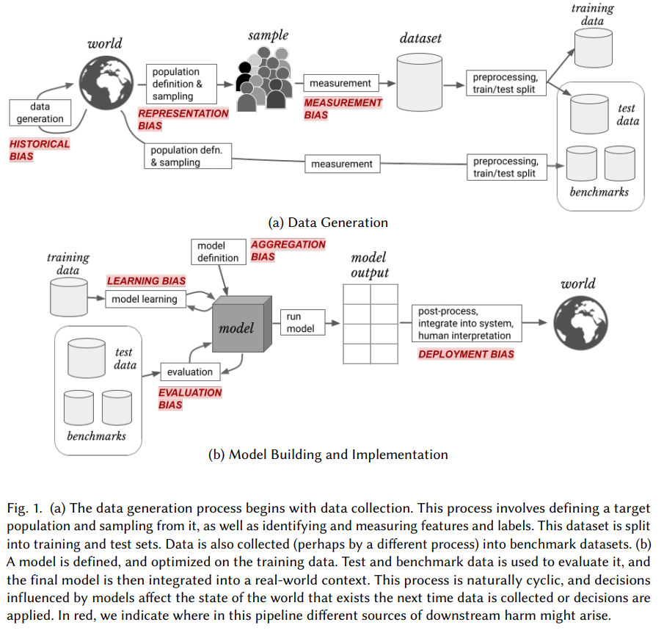
Bias in Machine Learning Cycle
[Surresh and Guttag 2021]
Notes:
Talk about these individually

Slide 70
Optimizing the target variable is not optimizing the outcome
Algorithm scores are a key input to decisions about future enrollment in care coordination programs
Less-healthy Blacks are scored at similar risk scores to more-healthy Whites which leads to disparities in program screening
Algorithm’s prediction on health needs is really a prediction on health costs
At a given level of health (measured by number of chronic illnesses), Blacks generate lower costs than Whites on average ($1,801 less per year, holding constant the number of chronic illnesses) [Obermeyer et al 2019]
Notes:
We quantify this by simulating a counterfactual world with no gap in health conditional on risk. Specifically, at some risk threshold a, we identify the supramarginal White patient (i) with Ri > a and compare this patient’s health to that of the inframarginal Black patient (j) with Rj < a. If Hi > Hj , as measured by number of chronic medical conditions, we replace the (healthier, but supramarginal) White patient with the (sicker, but inframarginal) Black patient. We repeat this procedure until Hi = Hj, to simulate an algorithm with no predictive gap between Blacks and Whites.

Slide 71
Healthcare Needs ≠ Healthcare Costs
Black patients generate very different kinds of costs: Fewer inpatient surgical and outpatient specialist costs, and more costs related to emergency visits and dialysis
“These results suggest that the driving force behind the bias we detect is that Black patients generate lesser medical expenses, conditional on health, even when we account for specific comorbidities”
Result: Optimizing for costs does not always lead to fair outcomes
[Obermeyer et al 2019]

Slide 72
Regulating AI/ML: Focusing on the Specific
Model performance is often assessed using data that is easily available, rather than data that reflects the target population of actual model use
Model performance using statistical measures is often conflated with demonstrating clinical impact and utility in care delivery
Clinical end users are often left ill-prepared to assess whether a model is generalizable to any particular setting
Metrics may be misapplied to hide true performance

Slide 73
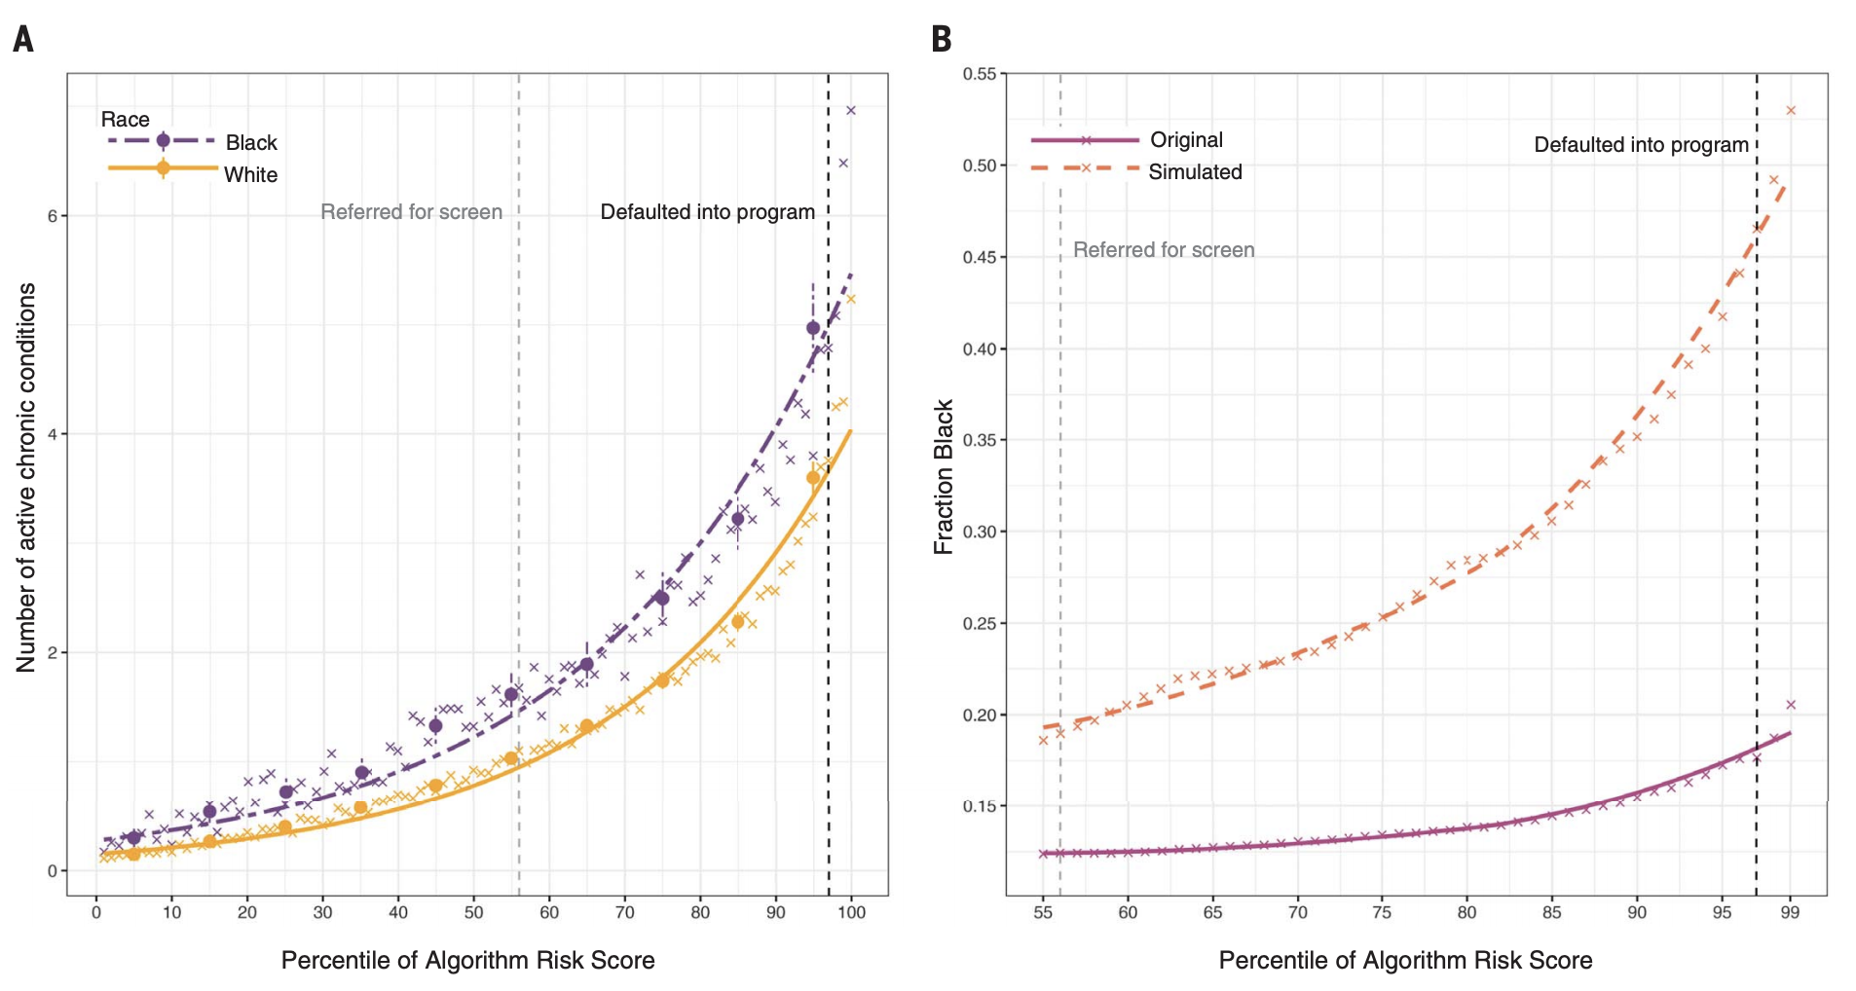
Treatment Effect is not monotonic
The predicted risk of some future outcome e.g., healthcare needs is widely used to target policy interventions under the assumption that the treatment effect is monotonic
However, this is however not always true
At the same level of algorithm-predicted risk, Blacks have significantly more illness burden than Whites
Calculate an overall measure of health status, the number of active chronic conditions [or “comorbidity score,” a metric used extensively in medical research to provide a comprehensive view of a patient’s health] by race, conditional on algorithmic risk score.
[Obermeyer et al 2019]
Notes:
a large academic hospital, we identified all primary care patients enrolled in risk-based contracts from 2013 to 2015. Our primary interest was in studying differences between White and Black patients

Slide 74
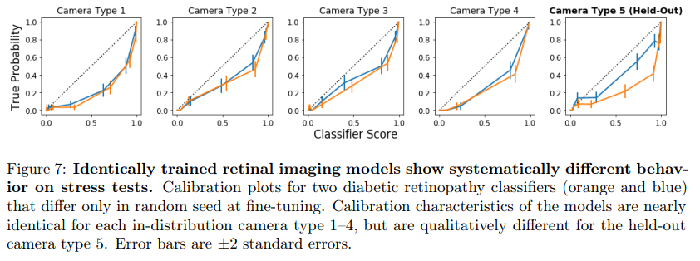
Underspecification in ML
Multiple ML models can roughly have the same performance in train-test but can vary wildly in performance when deployed
“An ML pipeline is underspecified if there are many predictors f that a pipeline could return with similar predictive risk”
[D'Amour et al 2020; Marx et al 2020]
Notes:
(different inductive bias but similar performance)
Some stress tests are also at odds with each other: models that were good at recognizing pixelated images were often bad at recognizing images with high contrast, for example. It might not always be possible to train a single model that passes all stress tests

Slide 75
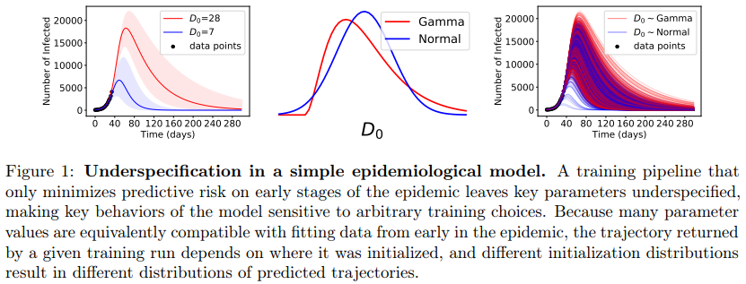
Consequences of Underspecification
Stress tests (contrived testing conditions) can be done to determine how well will the models do in different scenarios
Implications for Fairness: Predictive Multiplicity and underspecifiation can impact fairness and lead to unfair models
[D'Amour et al 2020; Marx et al 2020]

Slide 76
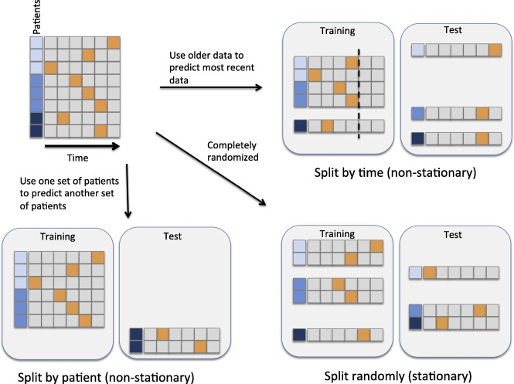
The Problem of Non-Stationarity
Real world data is characterized by non-stationarity. [Jung et al 2015]
Extended versions of ML algorithms can deal with concept drift while being fair
Use older data to predict most recent data
Split by time (non-stationary)
Split randomly (stationary)
Use of one set of patients to predict another set of patients
Split by patient (non-stationary)
If one is interested in “using the model on future data, then it appears that a substantially simpler model is best” [Jung and Shah 2015]
Notes:
Data may change over time and feedback loop may change characteristics of relevant classes

Slide 77
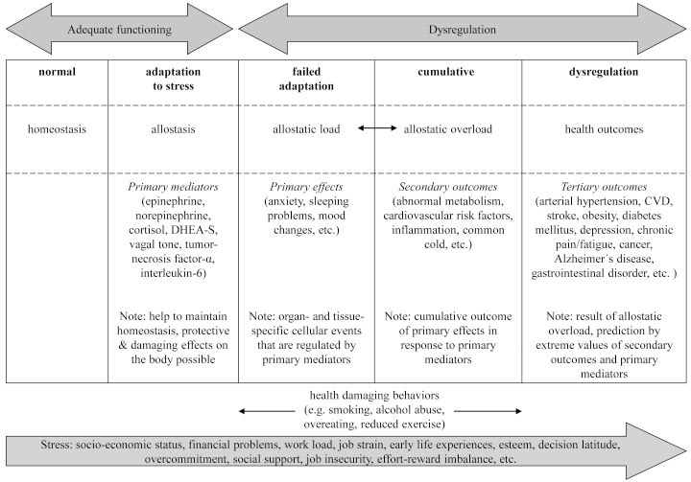
Modeling Long Term Impact of AI/ML
Well-being and health is a life-long and long term phenomenon/process
Long term dynamics in any system are hard to assess
Modeling under what circumstances does modeling criteria promote the long-term well-being of protected groups over time
In standard classification setting such scenarios are not considered
What is the cumulative effect of discrimination faced by an individual over the course of a lifetime?
[Mauss et al. 2015]

Slide 78
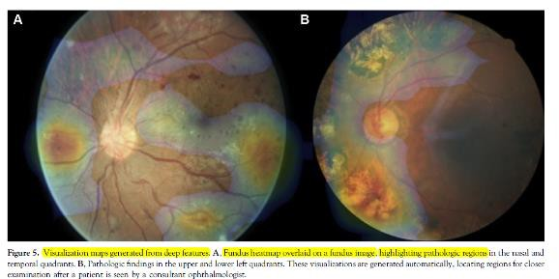
From High resource to Low resource environments
A practical limitation of deploying machine learning models is the shift in performance observed when moving from high resource to low resource environments
What are the regulatory obligations and resource support needed to ensure that translation of technology across high-to-low resource contexts happens
Most aspects of responsible AI like fairness, explainability, and performance usually break down
[Gargeya 2017]

Slide 79
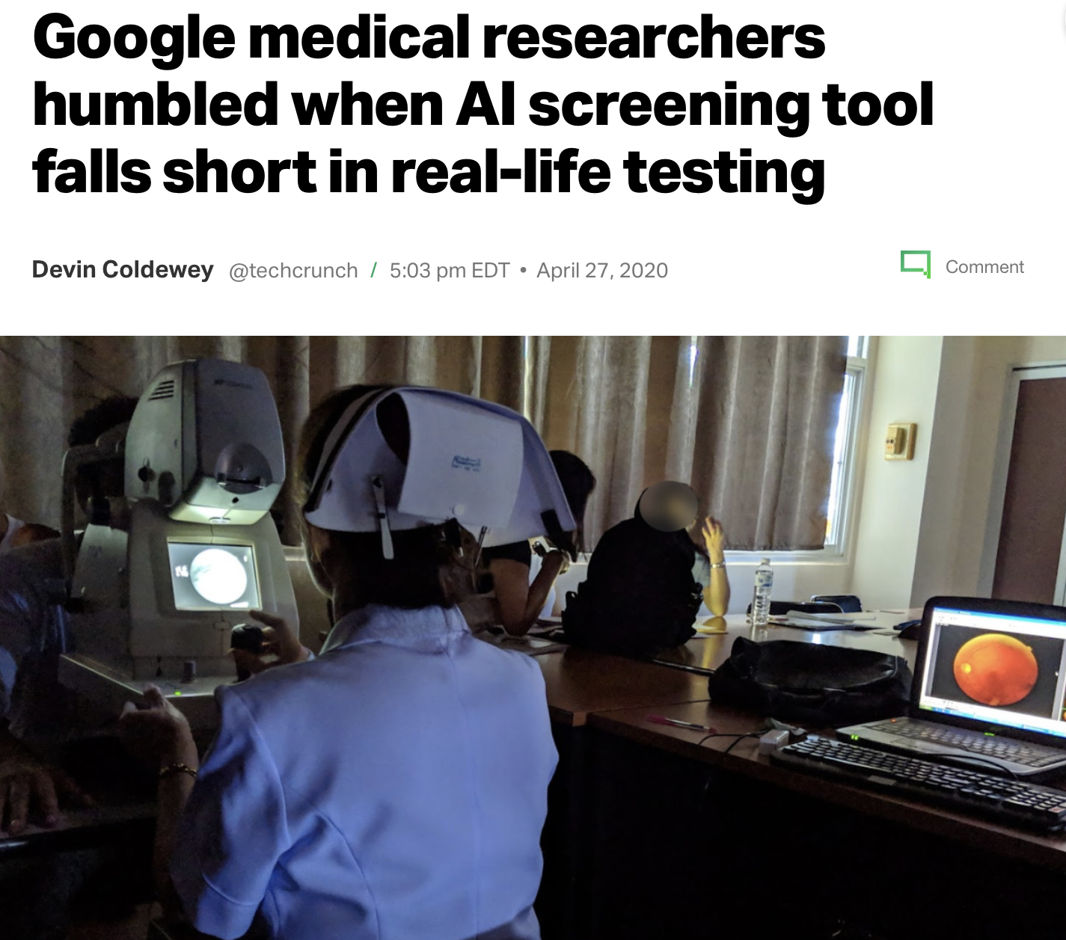
Generalization problems in moving from High resource to low resource environments
Deployment of Google’s Retinopathy tool in low resource environments
Clinics in Google’s study often experienced slower and unreliable connections
Example: In one clinic the internet went out for two hours during eye screening, reducing the number of patients screened by half (from 200 to 100)
Fewer people in this case received treatment because of an attempt to leverage this technology
Notes:
Images with obvious DR but poor quality would be refused by the system, complicating and extending the process. And that’s when they could get them uploaded to the system in the first place:
This causes some images to take 60-90 seconds to upload, slowing down the screening queue and limiting the number of patients that can be screened in a day.
Nurses tried various workarounds but the inconsistency and other factors led some to advise patients against taking part in the study at all

Slide 80
AI Audits in Responsible ML
Model risk management involves periodic look backs to evaluate the performance and the consequences of ML models in deployment
Internal processes vs external processes
Ad-hoc vs. Domain specific standard auditing process
Scalability and comprehensiveness
Challenges with race, ethnicity data that is either commonly missing or too coarse for meaningful evaluation

Slide 81
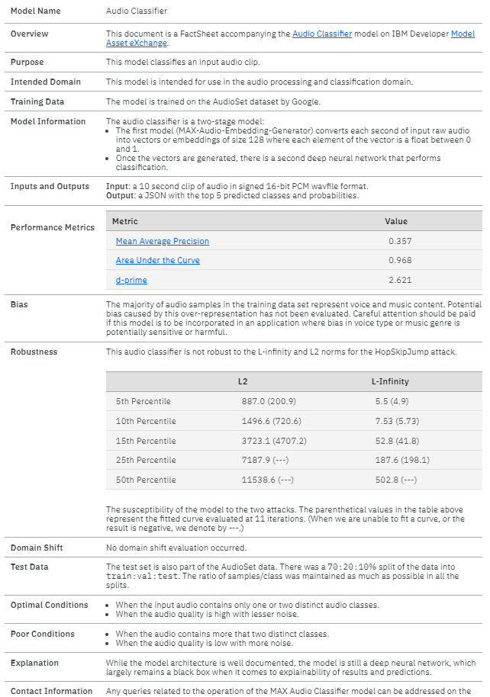
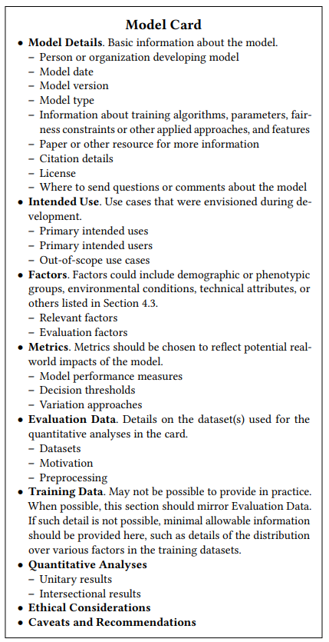
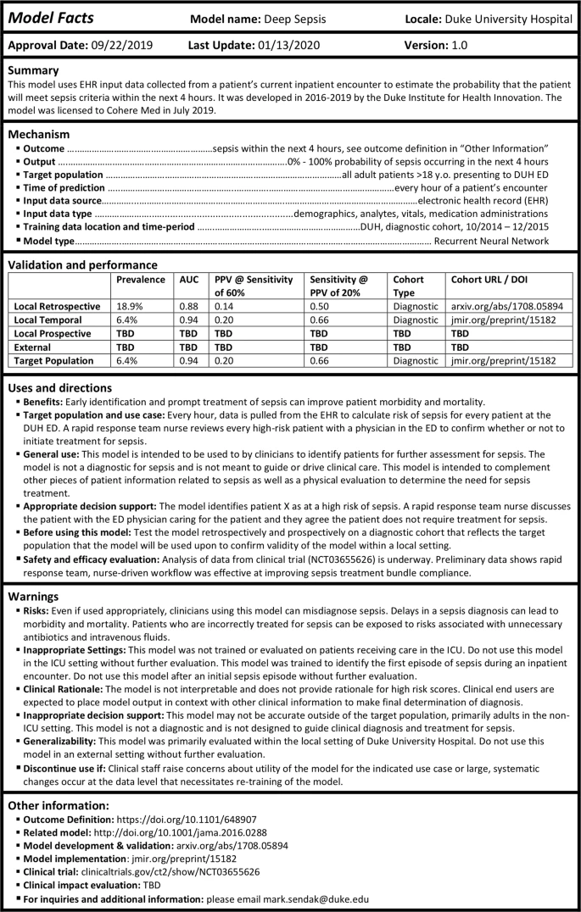
Responsible AI: Model Templates
[Arnold et al 2019]
[Mitchell et al 2019]
[Sendak et al 2020]
Notes:
Talk about our own proposal

Slide 82
Extraneous factors in Decision Making in AI/ML systems
Model risk management involves periodic look backs to evaluate the performance and the consequences of ML models in deployment
Internal processes vs external processes
Ad-hoc vs. Domain specific standard auditing process
Scalability and comprehensiveness
Challenges with race, ethnicity data that is either commonly missing or too coarse for meaningful evaluation
[Danziger et al 2011]

Slide 83
Comprehension, Cognition and Responsible AI
Since fairness metrics and fair models are likely to be used by non-experts it is important to gauge an average person’s understanding of fairness
Studies have found that “comprehension is lower for equal opportunity, false negative rate than other definitions”
Education is a strong predictor of comprehension of fairness metrics (Problem: Marginalized are more likely to be affected)
Those with the “weakest comprehension of fairness metrics also express the least negative sentiment toward them”
[Saha et al 2020]
Notes:
We do find, however, that comprehension is lower for equal opportunity, false negative rate than other definitions. In general, comprehension scores for equal opportunity (both FNR and FPR) were less internally consistent than other fairness rules, suggesting participant responses were also more “noisy” for equal opportunity. This is somewhat intuitive: equal opportunity is difficult to understand, as it only involves one type of error (FNR or FPR) rather than both.

Slide 84
How should algorithms be regulated?
Side Effects: Chemotherapy drugs can shrink a patient’s tumor but they can also have devastating side effects
Different effect on different populations: The blood thinner clopidogrel does not work in the 75% of Pacific Islanders as their bodies do not produce the enzyme for drug activation
Understanding who the product is for: Clinical researchers are required to “clearly define a drug’s target users so a prescribing clinician can have confidence that the drug has been successfully tested on similar patients.”
Understanding how the product was developed: Clinical trials have mandatory reporting requirements to ensure transparency and to hold product developers accountable
[Coravos et al 2019]
Notes:
Because algorithms may perform differently on populations for whom the algorithm was not developed, it is essential to ensure that algorithms specify and document which populations and use cases they apply to. Doing so provides confidence that the risks and rewards for the target group have been sufficiently studied and deemed an acceptable trade-off.
Algorithms should define the characteristics of the population in which they are intended to be used
for conducting ethical studies and publishing their results. Today’s high-stakes algorithms often don’t share their validation methods publicly, though; because companies are so protective of their algorithmic IP, it’s often unclear how a product has been tested or whether the results are reproducible. But understanding how products are developed can help to clarify and mitigate unintended outcomes.

Slide 85
Regulation: An FDA for ML and Algorithms?
In drug development FDA enforces protocols for manufacturers to prove the safety and effectiveness of drug products before they go on the market
Algorithms and ML models do no come with warning labels
Adverse Events: Drugs carry the risk of adverse events (injury, hospitalization etc.) A well-documented public reporting structure for handling such mishaps exists (as given by FDA) where reports of serious events like death, serious injury can be tracked
Ethical and quality control standards in healthcare: Good Clinical Practice (GCP) for clinical trials, Good Manufacturing Practice (GMP) for products, and Good Laboratory Practice (GLP) for research laboratories
[Coravos et al 2019]

Slide 86
Move fast and break things
Mark Zuckerberg
“Move fast and break things” just doesn’t work (in healthcare)
- Vic Gundotra
Notes:
Because people can die

Slide 87
Cultural Problems in Tech: AI as panacea Trap
Prevalence of AI as panacea trap leading to misuse of AI
Use of technology that is based on questionable concepts e.g., criminality based on facial recognition [Arcas 2017; Wu & Zhang 2017]
Emotion recognition Technologies with biased data and unproven foundation [Crawford 2021]
Failure of many AI technologies during COVID19 to have real world effect on mitigation of COVID [Wynants et al 2020]
Notes:
Wu and Zhang’s claim is that machine learning techniques can predict the likelihood that a person is a convicted criminal with nearly 90% accuracy using nothing but a driver’s license-style face photo.

Slide 88
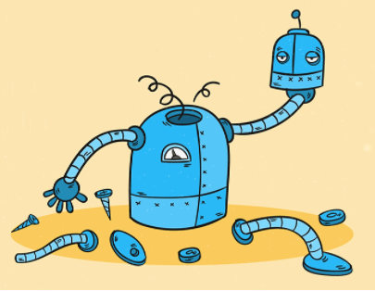
Cultural Problems in Tech: Technological solutionism
“Technological solutionism – the perception that technology will lead to only positive solutions” [Schwartz et al 2021]
Unintended consequences of AI for Good Technologies
Self-Tracking (health, driving) can start as a choice to improve oneself and results in benefits
“Eventually we will reach the point where people who decide not to self-track are assumed to be people who have something to hide. Then they have no choice but to start self-tracking” - Evgeny Morozov
Notes:
Technological solutionism often combined with a singular focus on tool optimization, can be at odds with operational scenarios, increasing the difficulty for the practitioners who have to make sense of tool output [Schwartz et al 2021]
If you can self-track and prove you are better than the average person – are healthier or drive more safely – you can get a better deal and claim some benefits. Eventually we will reach the point where people who decide not to self-track are assumed to be people who have something to hide. Then they have no choice but to start self-tracking
https://www.theguardian.com/technology/2013/mar/09/evgeny-morozov-technology-solutionism-interview

Slide 89
Community Initiatives
Neural Information Processing Systems (NeurIPS) introduced a requirement for submitting authors to include a statement on the broader societal impacts of their research [Prunkl et al 2021]
Papers are forwarded to ethics advisors if flagged for ethics and some were even rejected
IRBs: Unlike the NeurIPS requirement, IRBs are less concerned with the broader impacts of research and its downstream applications, but instead focus on the direct effects on human subjects during or after the research process.
Ethical assessment at conference reviews [ACM Signmetrics 2021]
Notes:
Historically, IRBs have been rare in computer science, compared to the social and biomedical sciences. However, the IRB system and other ethical review processes are becoming more embedded in computer science.

Slide 90
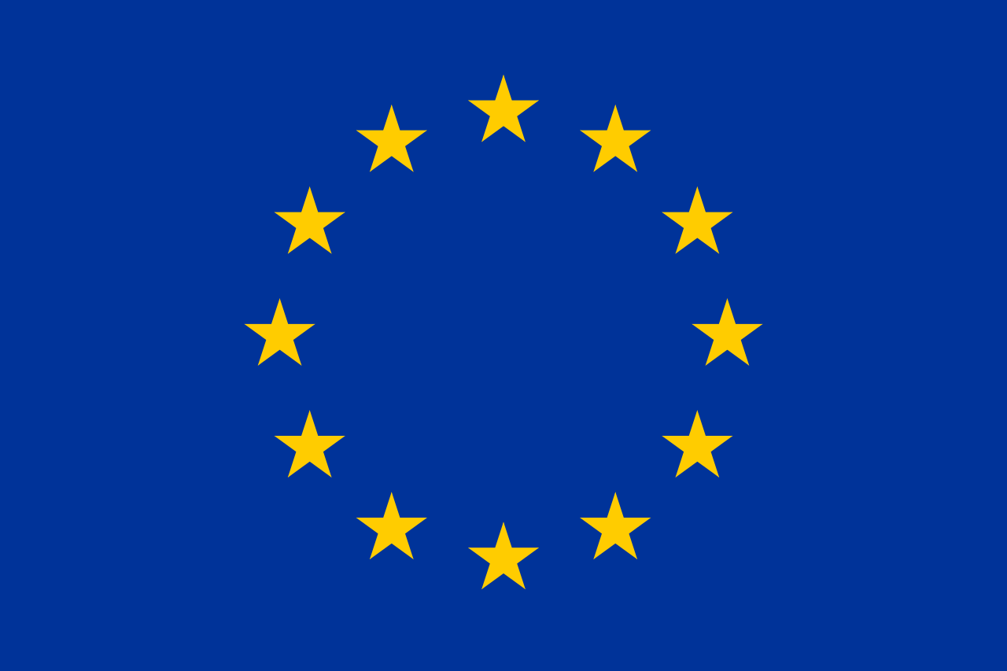
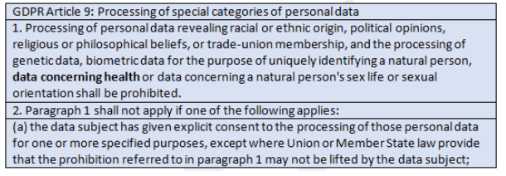
SaMD: Regulation in the EU
EU employs the same system device classification system that the US uses
Regulations are quite similar in many arenas
Effect of GDPR
Notes:
Basically, there is a long list of what cannot be processed without explicit consent. The processing of personal data revealing racial or ethnic origin, political opinions, religious or philosophical beliefs, or trade-union membership, as well as the processing of genetic data, biometric data for the purpose of uniquely identifying a natural person, data concerning health, or data concerning a natural person's sex life or sexual orientation, is prohibited without explicit consent.
Consent forms cannot be pre-selected, and they need to take into consideration the age of the patient, as well as patient nationality and special handling for children (i.e., parental consent).

Slide 91

SaMD: Regulation in China
National Medical Products Administration (NMPA), formerly (China Food and Drug Administration, or CFDA), issued guidelines for SaMD in 2019
The four main considerations for the registration of AI-Aided Software:
Needs analysis
Data collection
Algorithm design
Verification and validation
Minor data-driven software updates can be controlled through a quality management system without applying for Modification Registration
Notes:
Software version naming rules should cover algorithm-driven and data-driven software updates, and should list all typical scenarios for major software updates
https://chinameddevice.com/china-cfda-ai-software-guideline/
The four main considerations for the registration of AI-Aided Software:
Needs analysis
Data collection
Algorithm design
Verification and validation
The Guideline is “based on the characteristics of deep learning technology, combined with the intended use, usage scenarios and core functions of the software, focusing on software data quality control, algorithm generalization ability and clinical risk.” Stated by NMPA Interpretation of Guideline on AI-Aided Software.
In terms of software updates, the Guideline clarified that the software version naming rules should cover algorithm-driven and data-driven software updates, and should list all typical scenarios for major software updates. Minor data-driven software updates can be controlled through a quality management system without applying for Modification Registration.

Slide 92
Survey on Responsible AI in Healthcare
bit.ly/2U3XDCm

Slide 93
Break 2 (15 minutes)

Slide 94
Demo & Artifacts

Slide 95
Medical Device Industry Example

Slide 96
Library Demo

Slide 97
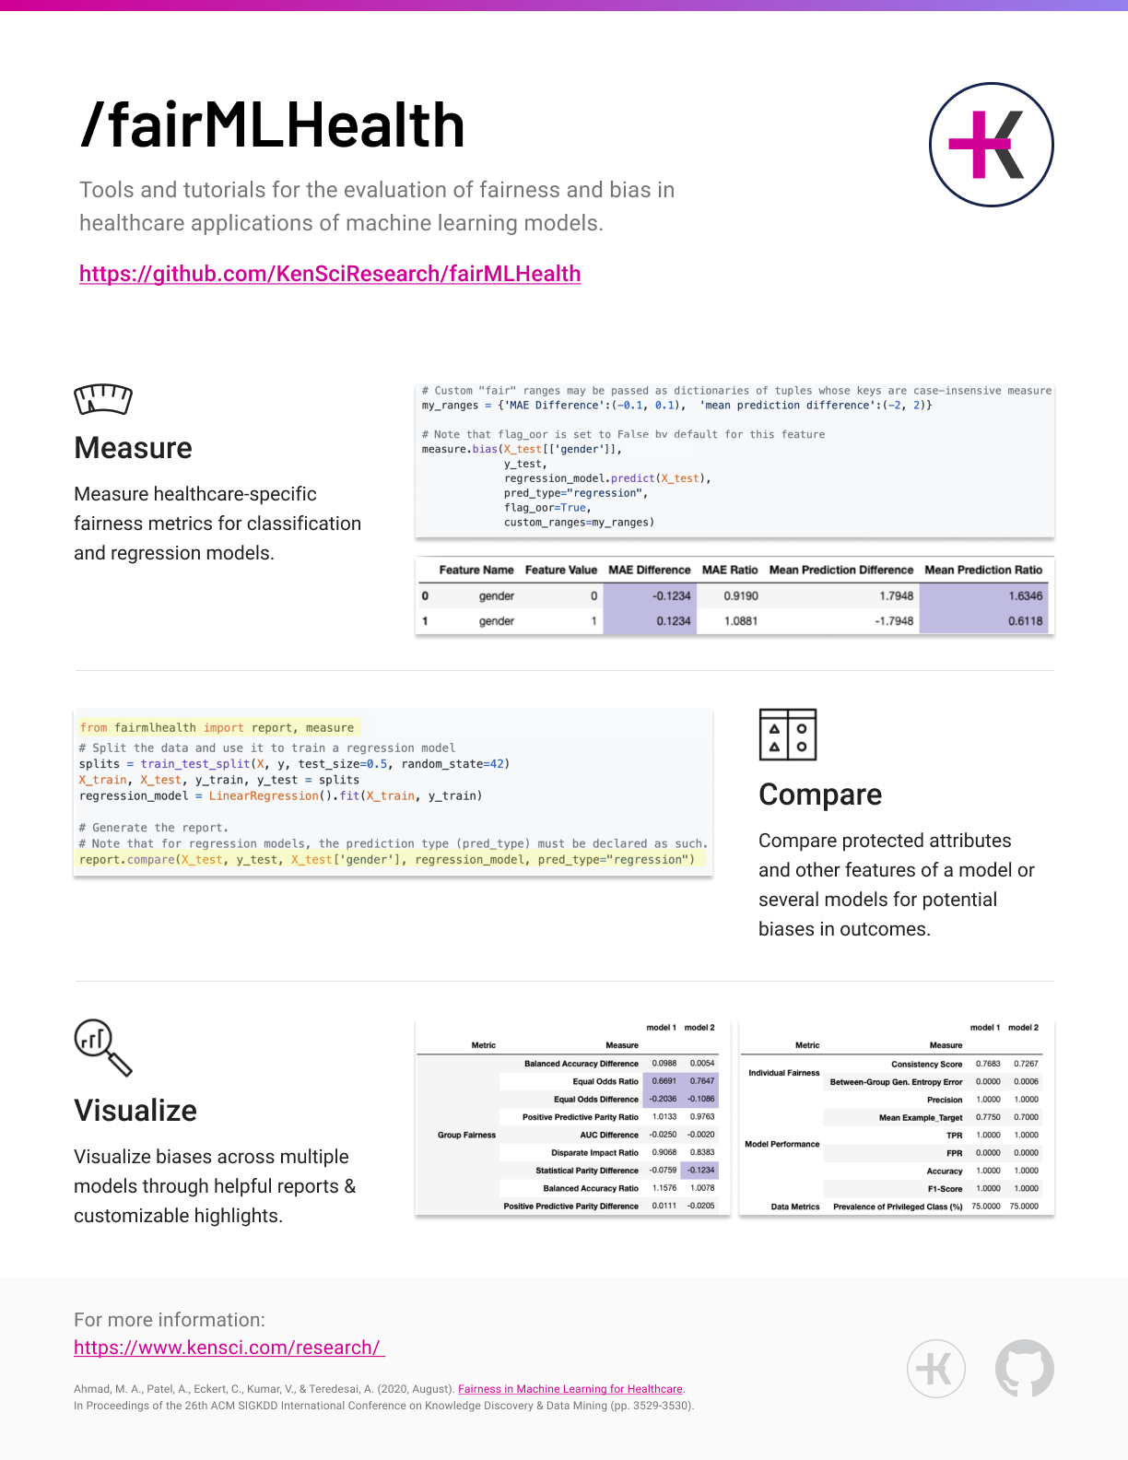

Slide 98
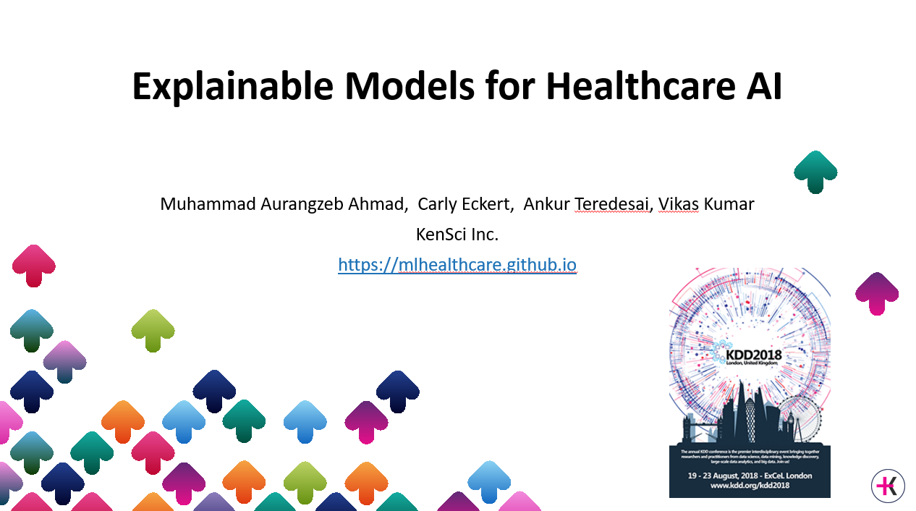
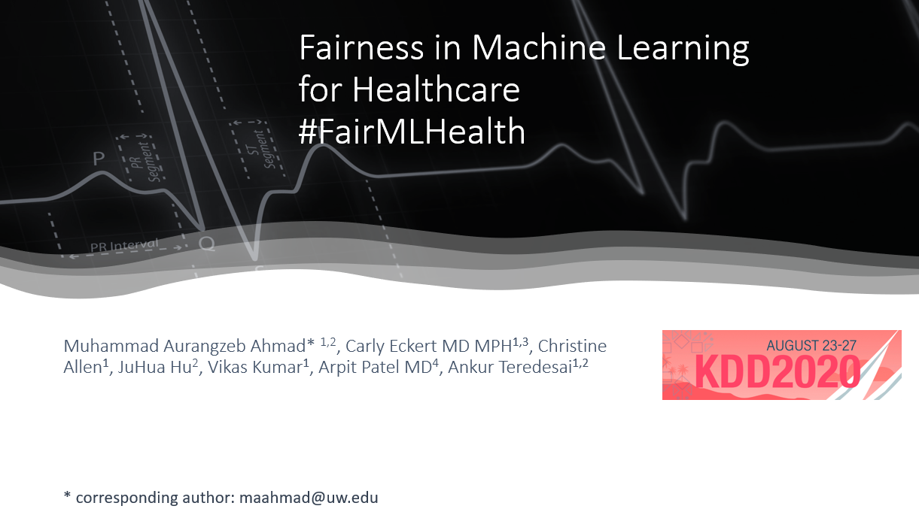
Software as a Medical Device: Regulating AI in Healthcare via Responsible AI
https://responsibleml.github.io/
Contact: maahmad@uw.edu
Additional Tutorials
https://www.youtube.com/user/vonaurum7
Survey on Responsible AI in Healthcare bit.ly/2U3XDCm

Slide 99
Survey on Responsible AI in Healthcare
bit.ly/2U3XDCm

Slide 100
Survey Results

Slide 101
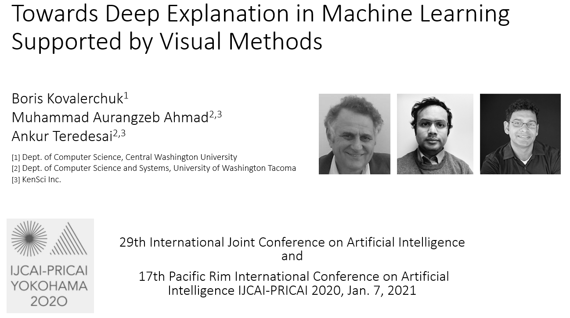
Additional Tutorials on Responsible AI
https://responsibleml.github.io/
https://www.youtube.com/user/vonaurum7

Slide 102
Conclusion
Responsible AI is a process rather than a product
AI/ML in Software as a medical device is an evolving area
Collaboration between regulators, physicians, patient advocates, the healthcare industry and AI/ML community is needed
Regulations and guidelines are necessary but not sufficient

Slide 103
Bibliography

Slide 104
Appendix

Slide 105
Overcoming Regulatory Shortcomings
Data Protection
Data Sovereignty
Federated Data
Clinical Trials
Design for Values
Compensation for errors
…. And many others

Slide 106
Responsible AI as Design Thinking

Slide 107
Fairness
Criteria for selecting a model – Accuracy, dispirate impact [Forde et al 2021]

Slide 108
Regulatory Landscape: Guidelines & Standards
Federal mandate for NIST [Presidential Document 2019]
FDA’s Artificial Intelligence and Machine Learning in Software as a Medical Device
NIST Guidelines [Schwartz et al 2021]
The Toronto Declaration on Machine Leaning and Human Rights
Council of Europe Guidelines on artificial intelligence and data protection

Slide 109
UK

Slide 110
Need for interdisciplinary perspectives

Slide 111
AI and the Law

Slide 112
AI and the Law: Success

Slide 113
AI and the Law: Failures

Slide 114
The view from Social Sciences & Humanities

Slide 115
Key Lessons 1
Binns Paper

Slide 116
Key Lessons 2

